Slide 1
Understanding contraceptive discontinuation as part of sustainable mCPR growth
Evidence from the Ethiopia DHS 2024–25 contraceptive calendar
1

Slide 2
Sustaining mCPR growth depends on entry and retention - which is a stock-and-flow problem
New / returning
modern users
Modern method
user stock
Exits from
modern use
Current users can continue,
switch, or exit
New entrants also face future
discontinuation risk
Modern-use exit affects the mCPR
numerator
1
2
3
Discontinuation is not simply a method outcome. It affects whether a woman remains in the modern-user stock.
The method mix of new starts shapes where future retention needs will concentrate.
If a woman stops a modern method and does not immediately move to another modern method, she leaves the mCPR numerator.
2
2
2
2
2

Slide 3
Questions guiding the discontinuation analysis
1
What methods are women using and how is method mix changing over time?
2
When are methods discontinued, and how does timing differ by method?
3
Why are methods discontinued, and how do reasons vary by method and timing?
4
How do discontinuation, switching, and modern-use exit vary across subgroups and geographies?
5
How do discontinuation pathways affect whether women remain in modern use?
6
What longer trajectories follow discontinuation, including stable use, churn, re-entry, or prolonged nonuse?
7
What is the population-level burden of modern-use exit, and what could increased retention mean for mCPR?
3

Slide 4
Modern contraceptive use in Ethiopia
Method mix among current modern users
Current modern use
22.7%
of all women aged 15–49 currently use a modern method
Share of current modern users (%)

Slide 5
Entry methods set the denominator for future retention risk
Overall initiation mix
Initiation mix by calendar year
Injectables
Implants
Pill
IUD
EC
Other modern
Non-modern methods

Slide 6
About 40% of modern-method episodes are discontinued within 12 months. Pills and injectables have the highest 12-month discontinuation rates.
70%
Pill 67.4%
60%
50%
Injectables 44.5%
40%
25.6%
All modern 39.1%
Cumulative discontinuation probability
30%
Other modern 36.2%
16.2%
IUD 24.7%
20%
Implants 16.0%
10%
0%
0
3
6
9
12
Months since method initiation
Other modern: male condom, female and male sterilization, LAM, SDM, and other modern methods; excludes IUD. All modern and Other modern exclude EC.

Slide 7
Injectables account for most method starts and have the second-highest 12-month discontinuation rate
Percent
Share of all method starts
12-month discontinuation

Slide 8
Understanding discontinuation reasons, risk factors, and regional differences
1
Reasons
2
Risk factors
3
Regions
Which reasons account for discontinuation and when do they emerge?
What factors are associated with a higher discontinuation rate?
Which regions have higher discontinuation rates and why?

Slide 9
Different reasons for discontinuation call for different responses
Actionable and can be addressed by programs
Not a program failure / retained in modern use
Side effects / health concerns
Counseling quality, side-effect management, method-fit support
Wanted to become pregnant
Access / cost / convenience barriers
Stopping reflects reproductive intention, not a service gap.
Resupply, availability, affordability, service delivery
Husband/partner disapproval
Changed preferences / circumstances
Partner, community, and provider engagement
Stopping can be appropriate; interpretation depends on intention, destination, and later outcomes.
Method failure / unintended pregnancy
Correct use, method fit, follow-up, quality of counseling
Successful modern switch
Wanted a more effective method
She stops a method but remains protected because she is able to switch to another modern method right away.
Switching support and access to the preferred method
Program interpretation depends on destination: method discontinuation is diagnostic; modern-use exit is the mCPR-relevant outcome
9

Slide 10
Nearly half of discontinuations reflect a desire to become pregnant
Wanted to become pregnant
47.6
Wanted a more effective method
13.9
Other
13.3
Side effects / health
12.8
Access / cost / convenience
9.5
Method failure / pregnancy while using
2.2
Husband/partner disapproved
0.8
Other includes infrequent sex/husband away, marital dissolution/separation, up to God/fatalistic, difficult to get pregnant/menopausal, other, and don’t know.

Slide 11
Discontinuation reflects pregnancy intentions and potential service gaps
47.6%
39.1%
13.3%
Not a program failure
Potentially actionable
Circumstantial
Wanted to become pregnant.
Side effects or health, access barriers, wanting a more effective method, method failure, or partner disapproval.
Infrequent sex or partner away, separation, fatalistic reasons, reduced fertility or menopause, other, or don’t know.

Slide 12
Reasons for discontinuation differ by method
Share of recorded discontinued episodes (%)
Wanted to become pregnant
Method experience or access
Husband/partner disapproved
Other reasons
Method experience or access includes failure, wanting a more effective method, side effects/health, and access, cost or inconvenience; Other reasons includes infrequent sex/partner away, separation, reduced fertility/menopause, fatalistic reasons, other and don’t know. Other modern includes condoms, sterilization, LAM, SDM and residual modern methods; IUD is separate and EC is excluded.
Percentages sum to 100 within each method before rounding.

Slide 13
Method experience and access contribute most to 12-month discontinuation across methods
2.2
Pill
18.7
28.2
18.4
67.4
0.6
Injectables
18.4
18.8
6.8
44.5
3.8
Other modern methods
19.0
13.4
36.2
1.4
IUD
9.7
13.5
24.7
1.7
Implants
6.1
8.3
16.0
0.6
All modern methods
14.9
17.0
6.7
39.1
0
20
40
60
80
12-month cumulative discontinuation (%)
Wanted to become pregnant
Method experience or access
Husband/partner disapproved
Other reasons
Method experience or access includes failure, wanting a more effective method, side effects/health, and access, cost or inconvenience. Other reasons includes infrequent sex/partner away, separation, reduced fertility/menopause, fatalistic reasons, other and don’t know. Other modern includes condoms, sterilization, LAM, SDM and residual modern methods. IUD is separate and EC is excluded.

Slide 14
Who is more likely to discontinue a modern method?
Characteristic
Adjusted 12-month probability (%)
Estimate (95% CI)
Age at start
15–19
38.5 (31.7–45.4)
20–24
38.2 (34.0–42.4)
25–34
40.0 (36.9–43.0)
35–49
38.6 (33.6–43.5)
Parity at start
0
55.7 (48.6–62.9)
1–2
38.3 (35.3–41.3)
3+
35.0 (31.2–38.7)
Education
None
41.4 (37.2–45.5)
Primary
37.9 (34.3–41.5)
Secondary+
38.8 (35.6–42.0)
Household wealth
Poorest 40%
41.8 (37.2–46.3)
Middle 20%
38.4 (34.0–42.8)
Richest 40%
38.2 (35.2–41.2)
Residence
Rural
38.6 (35.8–41.4)
Urban
39.7 (35.4–44.0)
0
20
40
60
12-month cumulative probability of ending the original method

Slide 15
Subnational analysis shows that Tigray has the highest 12-month modern-method discontinuation. Method experience and accessibility represent main reasons for discontinuation.
Ending the original method (%)
Reasons among first-year discontinuations (%)
National 38.9
Wanted to become pregnant
Method experience / access
Partner disapproved
Other
Tigray
51.0
Tigray
37.2
46.3
0.4
16.1
Benishangul-Gumuz
50.4
Benishangul-Gumuz
30.5
36.5
1.3
31.6
Gambella
47.8
Gambella
27.4
45.0
0.9
26.8
Afar
47.7
Afar
30.3
41.9
0.0
27.9
Central Ethiopia
46.5
Central Ethiopia
41.7
48.2
1.2
8.9
Somali (30 episodes)
45.8
Somali (11 events)
19.8
41.1
0.0
39.1
Harari
41.4
Harari
30.2
47.7
0.0
22.1
South Ethiopia
40.7
South Ethiopia
31.5
43.5
0.9
24.1
Oromia
39.3
Oromia
38.7
43.5
2.6
15.2
Amhara
38.4
Amhara
41.1
39.3
1.1
18.4
Addis Ababa
33.5
Addis Ababa
34.1
45.9
0.0
20.0
South West Ethiopia
32.3
South West Ethiopia
35.2
52.0
1.8
11.0
Sidama
31.2
Sidama
32.3
56.8
0.6
10.3
Dire Dawa
29.9
Dire Dawa
35.7
49.4
1.3
13.6
0
20
40
60
Other includes infrequent sex or husband away and marital dissolution or separation. It also includes reduced fertility or menopause, fatalistic reasons, other, and don’t know.

Slide 16
Why do regions differ in contraceptive discontinuation?
01
02
03
Measure regional
variation
Explain regional
gaps
Link service
context
Where is risk high and
the burden large?
Do different users and
methods explain the gap?
Which conditions track
the remaining gaps?
Compare discontinuation,
modern-use exits, and mCPR.
Use adjusted survival models
and Oaxaca–Blinder
decomposition to assess how
method mix and differences
in characteristics such as age,
parity, and wealth, among
others, explain regional gaps.
Use multilevel survival
models linked to service data
to examine associations with
supply, access, counseling,
and support for switching.

Slide 17
mCPR and discontinuation guide targeting
Higher
Improve access
and retention
Support continuation
and switching
Low uptake, high discontinuation
High uptake, high discontinuation
Expand method access and
reduce exits.
Strengthen method choice,
switching, and follow-up.
Discontinuation
Build demand, access,
and continuity
Sustain uptake
and continuation
Low uptake, low discontinuation
High uptake, low discontinuation
Address barriers to uptake
and support continued use.
Maintain continuity and study
practices worth adapting.
Lower
Lower modern uptake
Higher modern uptake
Modern contraceptive prevalence (mCPR)

Slide 18
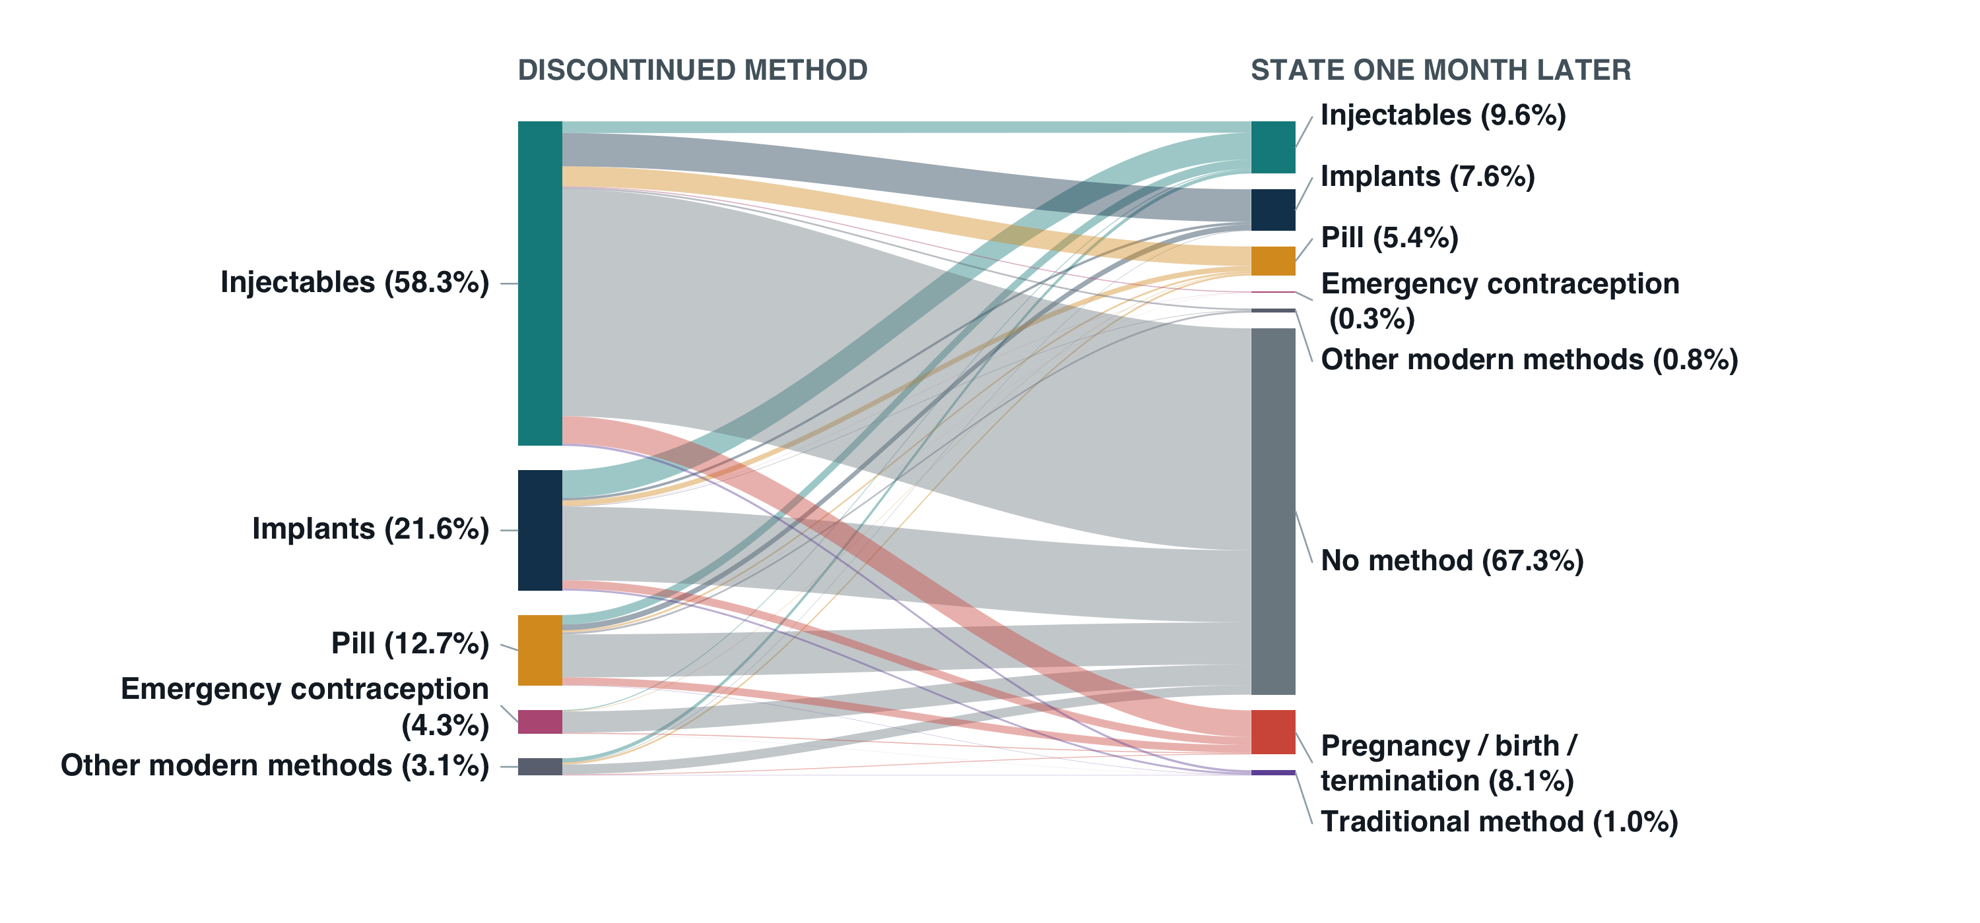
One month after stopping a modern method for reasons other than wanting pregnancy, 67% were using no method

Slide 19
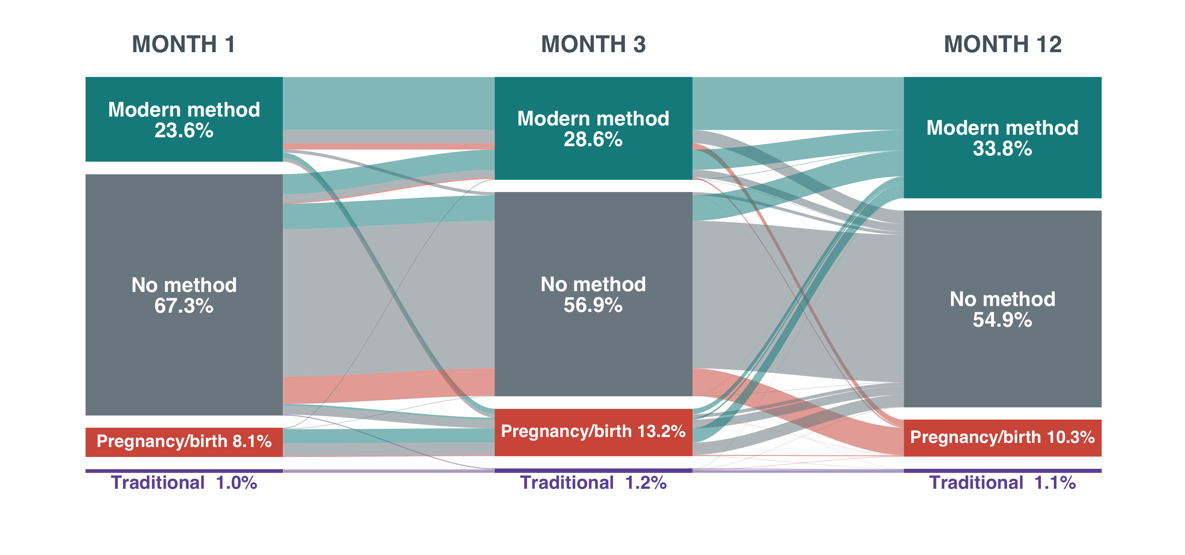
Modern use rises by month 12, but nonuse persists

Slide 20
A single discontinuation tells us what happened once. Trajectories show whether it becomes a pattern.
Contraceptive use changes as women’s needs and circumstances change. Women may start, stop, switch methods, and return to use over time.
Following each woman across five years reveals patterns that individual episodes cannot show.
Separate switching from interruptions
Distinguish brief gaps from prolonged nonuse
Identify repeated stopping and restarting
A change in modern method can maintain continuous use without a gap.
Short gaps followed by return differ from a long period without a method.
Repeated stops and restarts can reveal instability that individual episodes miss.
Brief gap and return
Continuous modern use
Prolonged nonuse
Stops, switches, and returns
Modern method A
Modern method B
Traditional method
No method
Pregnancy or birth

Slide 21
Trajectories distinguish switching from interruptions in use. Gaps may be temporary, repeated, or sustained.
Illustrative profiles
YEAR 1
YEAR 2
YEAR 3
YEAR 4
YEAR 5
Stable modern use
Continuous modern use
Switch with continuity
No gap in modern use
Modern to traditional
Switch outside modern use
Brief gap and return
Short gap, then return
Repeated churn
Multiple stops and restarts
Early exit
Prolonged nonuse
Predominant nonuse
Little modern method use
Modern method A
Modern method B
Traditional method
No method
Pregnancy or birth
Compare profile prevalence, user characteristics, and regional concentration to identify priorities for switching support, continuity of supply, and return to use.

Slide 22
From discontinuation diagnostics back to mCPR
The analysis shows when methods end and what follows. We can use these risks and transitions to estimate users retained or lost and the implications for mCPR.

Slide 23
Sustained mCPR growth depends on entries and continued modern use
New and returning users
At the start of the year
At year end
Enter modern use during the year
Current modern users
Modern users at year end
Continued use and switching
Women already using a modern method
Continued users, new adopters, and women who return
Exits from modern use
No method or traditional use at year end
A method switch can maintain modern use.

Slide 24
Discontinuation risks can inform user counts and mCPR impact
Estimate users at risk
Apply relevant risks
Estimate users affected
Use the number of women aged 15–49, mCPR, and current method mix to estimate current users.
Use 12-month life-table discontinuation probabilities by method and reason.
Estimate discontinuations and women affected by method, reason, and in total.
Add new and returning users when they enter.
Account for time already using a method and when new users start.
Track switching and return to estimate exits from modern use.
Focus on potentially addressable gaps
Estimate what support could change
For example, stopping because of side effects while pregnancy prevention is still desired.
Compare support scenarios. Report additional modern users at year end and the corresponding change in mCPR.

Slide 25
Estimated 12-month discontinuations by method
Women aged 15–49: 34.06 million
mCPR: 22.7%
Current modern users: 7.74 million
Method | Current mix (%) | Current users | 12-month risk (%) | Estimated discontinuations
Injectables | 57.5 | 4,455,000 | 44.5 | 1,981,000
Implants | 29.6 | 2,288,000 | 16.0 | 367,000
Pill | 7.1 | 547,000 | 67.4 | 369,000
IUD | 2.5 | 190,000 | 24.7 | 47,000
Other modern methods | 2.5 | 194,000 | 36.2 | 70,000
EC | 0.9 | 66,000 | Not applied | Not estimated
Total, excluding EC | 99.1 | 7,675,000 | 36.9 | 2,835,000

Slide 26
Estimated 12-month discontinuations by reason
Current users covered: 7.67 million (excluding EC)
Total: 2.83 million
Reason | Estimated discontinuations | Share of estimated discontinuations (%)
Wanted to become pregnant | 1,086,000 | 38.3
Other | 469,000 | 16.5
Side effects / health | 449,000 | 15.8
Wanted a more effective method | 416,000 | 14.7
Access / cost / convenience | 317,000 | 11.2
Method failure / pregnancy while using | 60,000 | 2.1
Husband/partner disapproved | 38,000 | 1.3
Total | 2,835,000 | 100.0

Slide 27
Appendix: interpreting the preliminary user counts
Main takeaways
Limitations
About 7.74 million women currently use a modern method. Applying first-year risks implies 2.83 million original-method endings in this planning scenario.
Injectables account for about 70% of estimated endings. Their large user population and substantial discontinuation risk make continuation and switching support especially relevant.
Side effects or health concerns account for about 449,000 endings and access barriers for 317,000. Wanting pregnancy accounts for 38.3% of estimated endings.
Current users have different durations of use. Their next-12-month risks require probabilities conditional on how long they have already used the method.
Method endings do not directly measure losses from modern use. Switching and returning to use can preserve mCPR. This calculation also excludes future entrants.
Counts depend on population and pooled risk assumptions, exclude EC, and have no uncertainty intervals yet. Reported reasons do not establish how much discontinuation an intervention could prevent.

Slide 28
Focus on potentially actionable discontinuation
The next regional analyses and user-count illustrations focus on method experience and access reasons. Later mCPR scenarios describe overall growth.

Slide 29
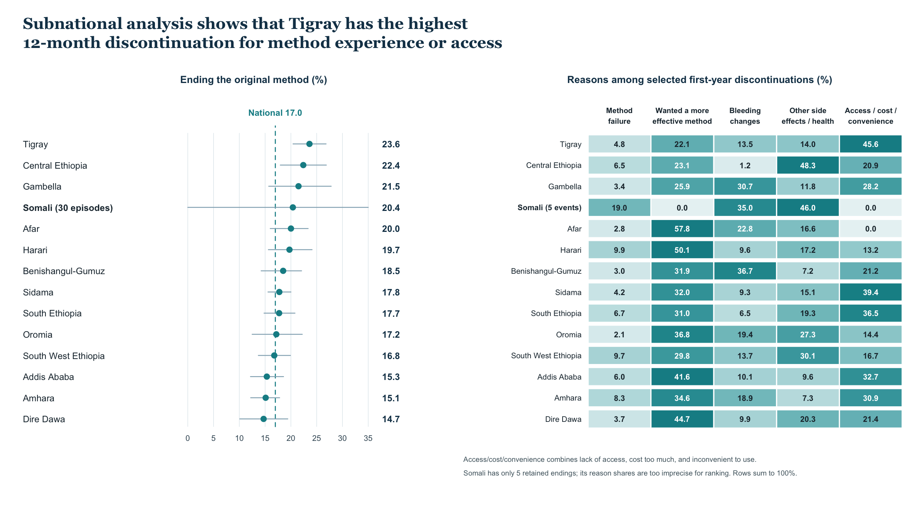

Slide 30
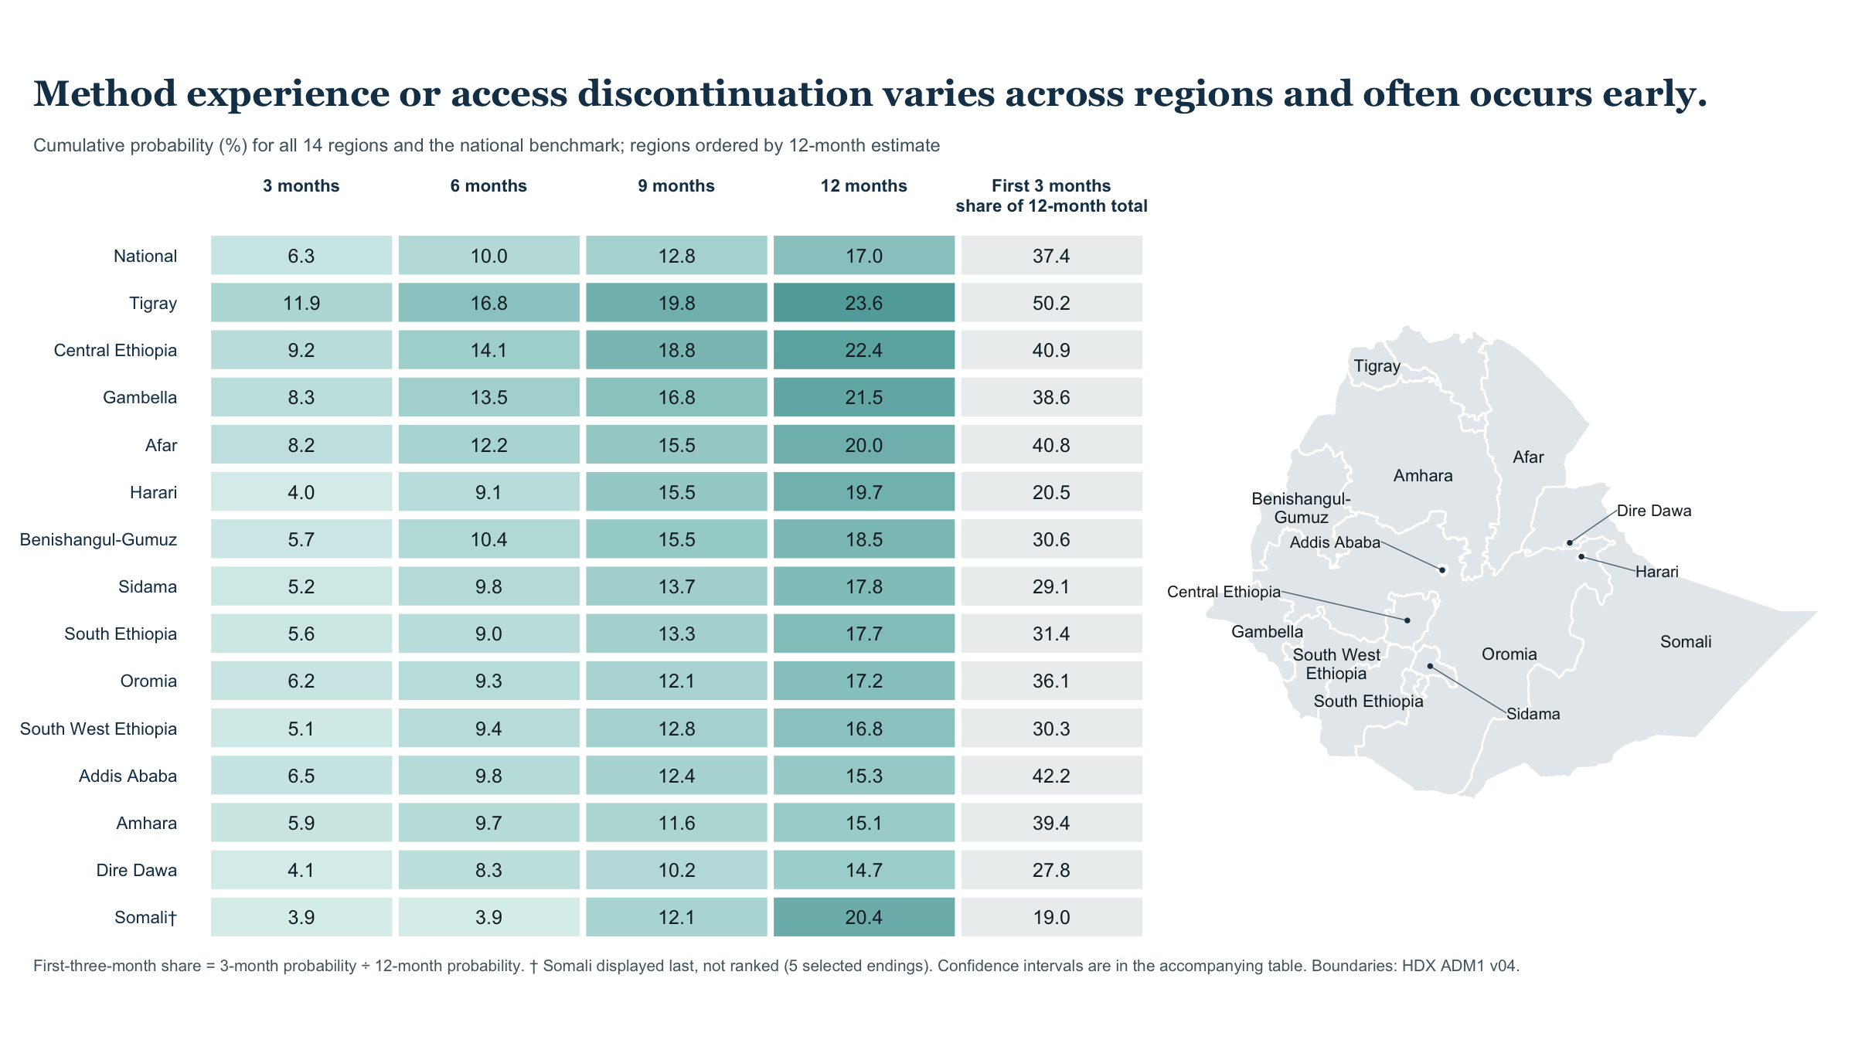

Slide 31
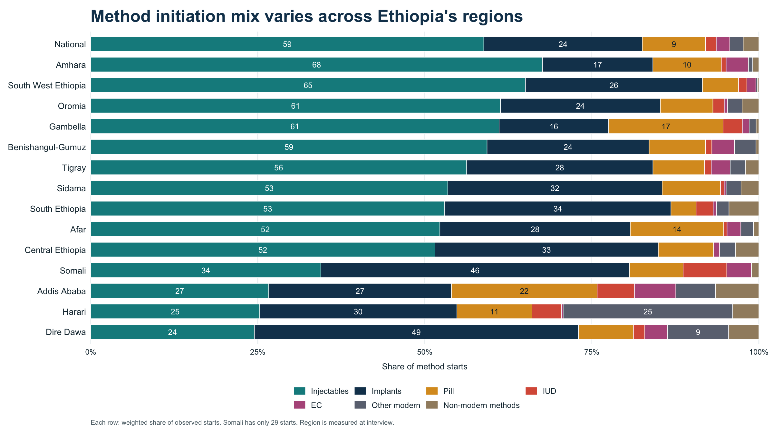

Slide 32
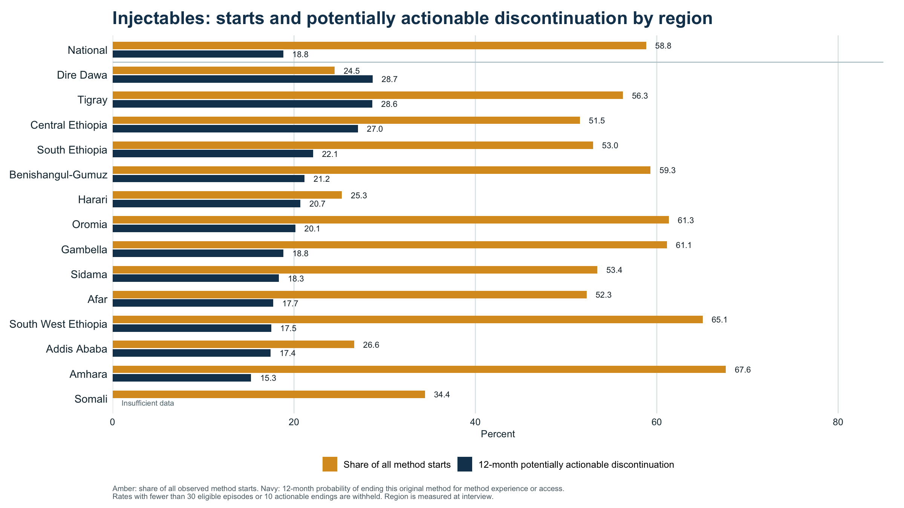

Slide 33
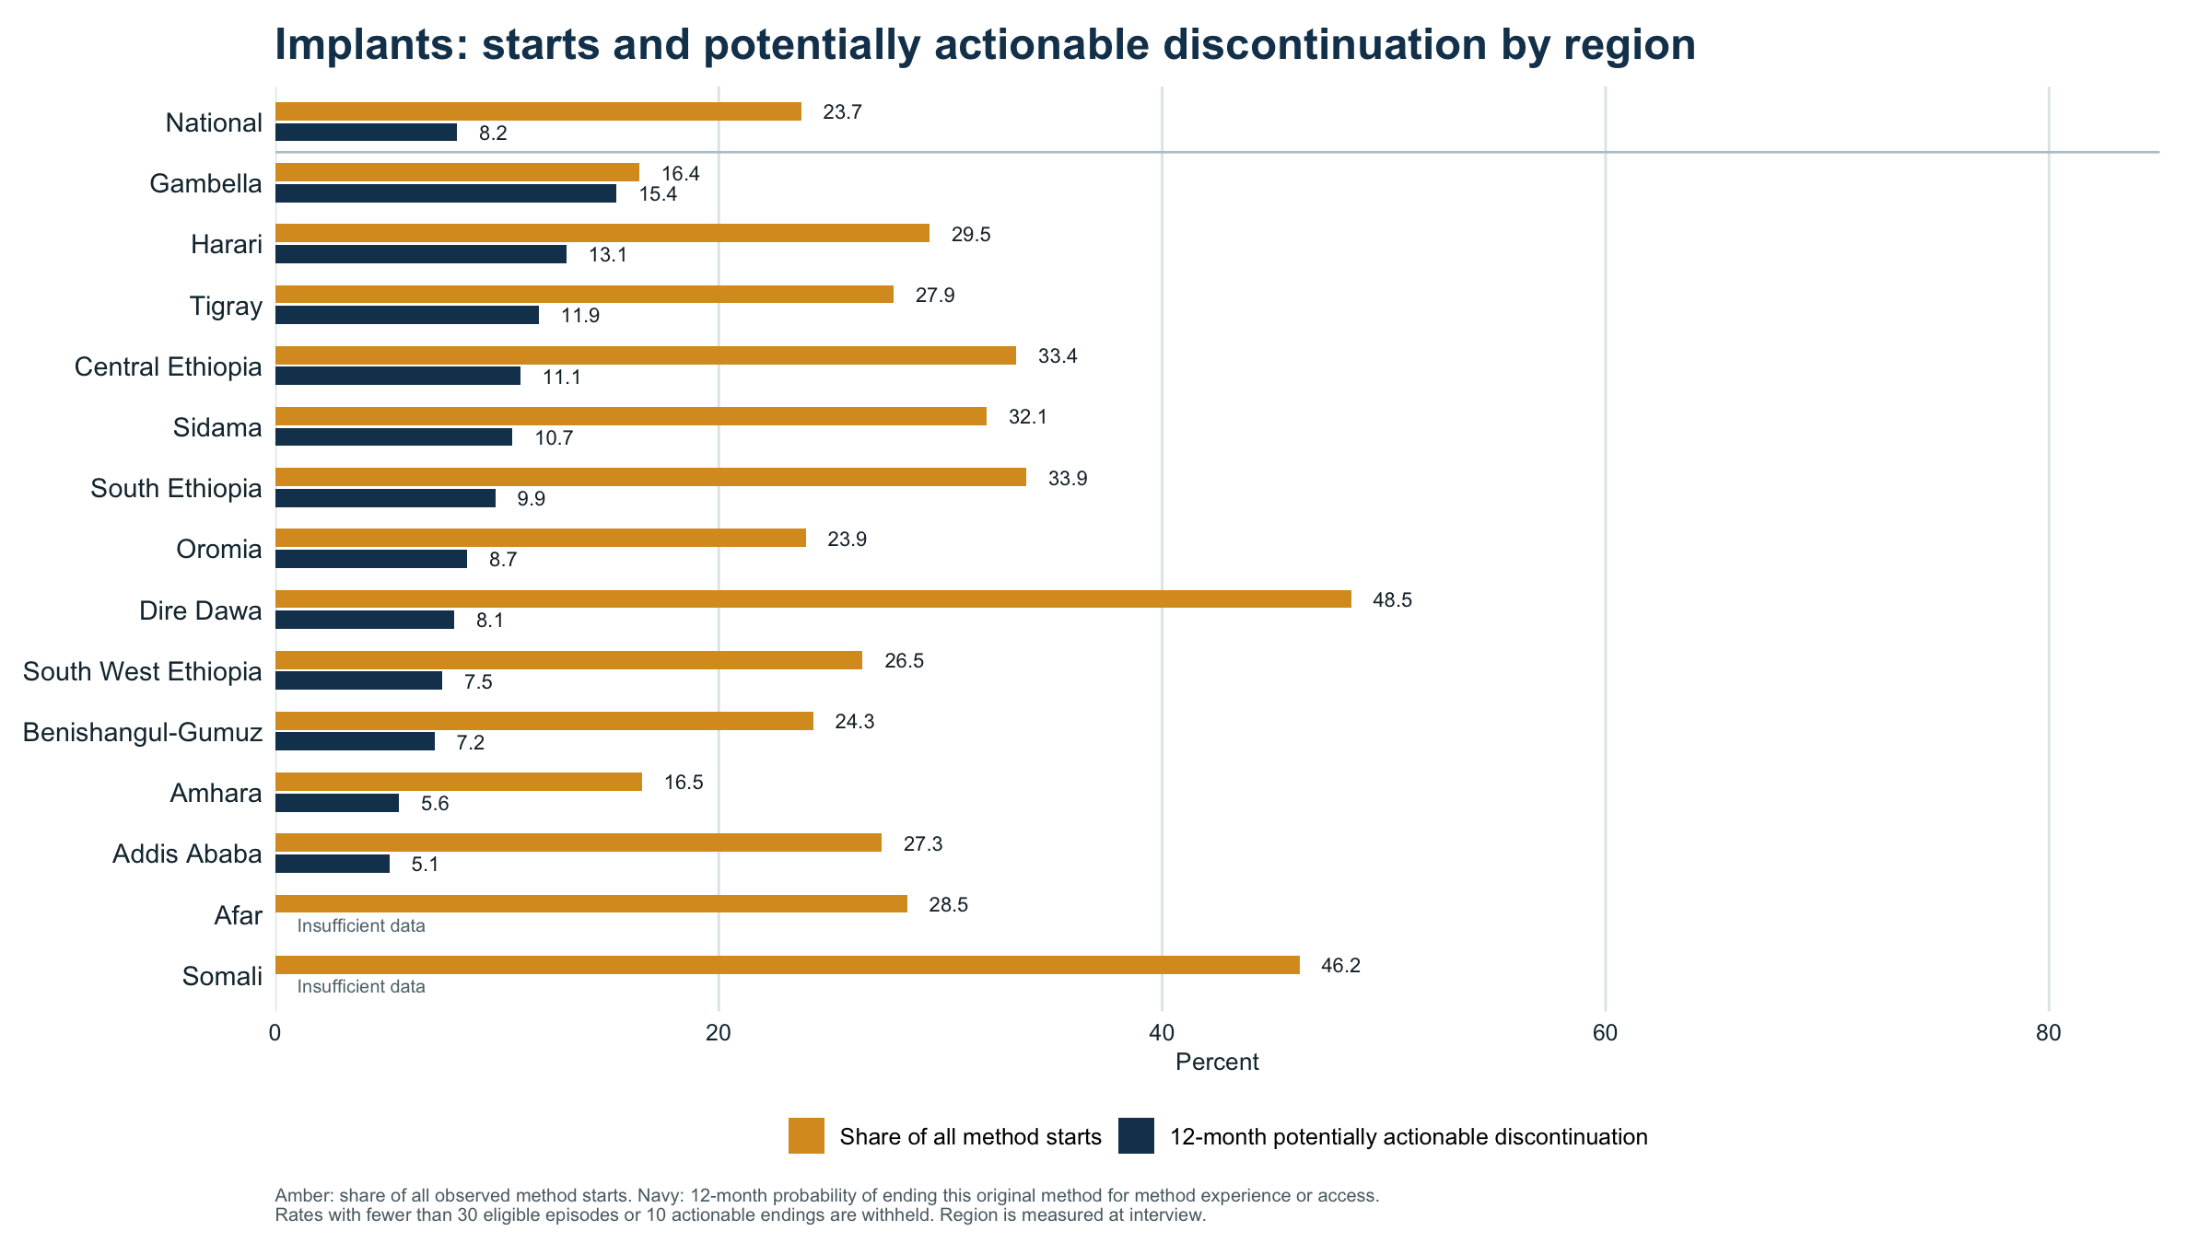

Slide 34
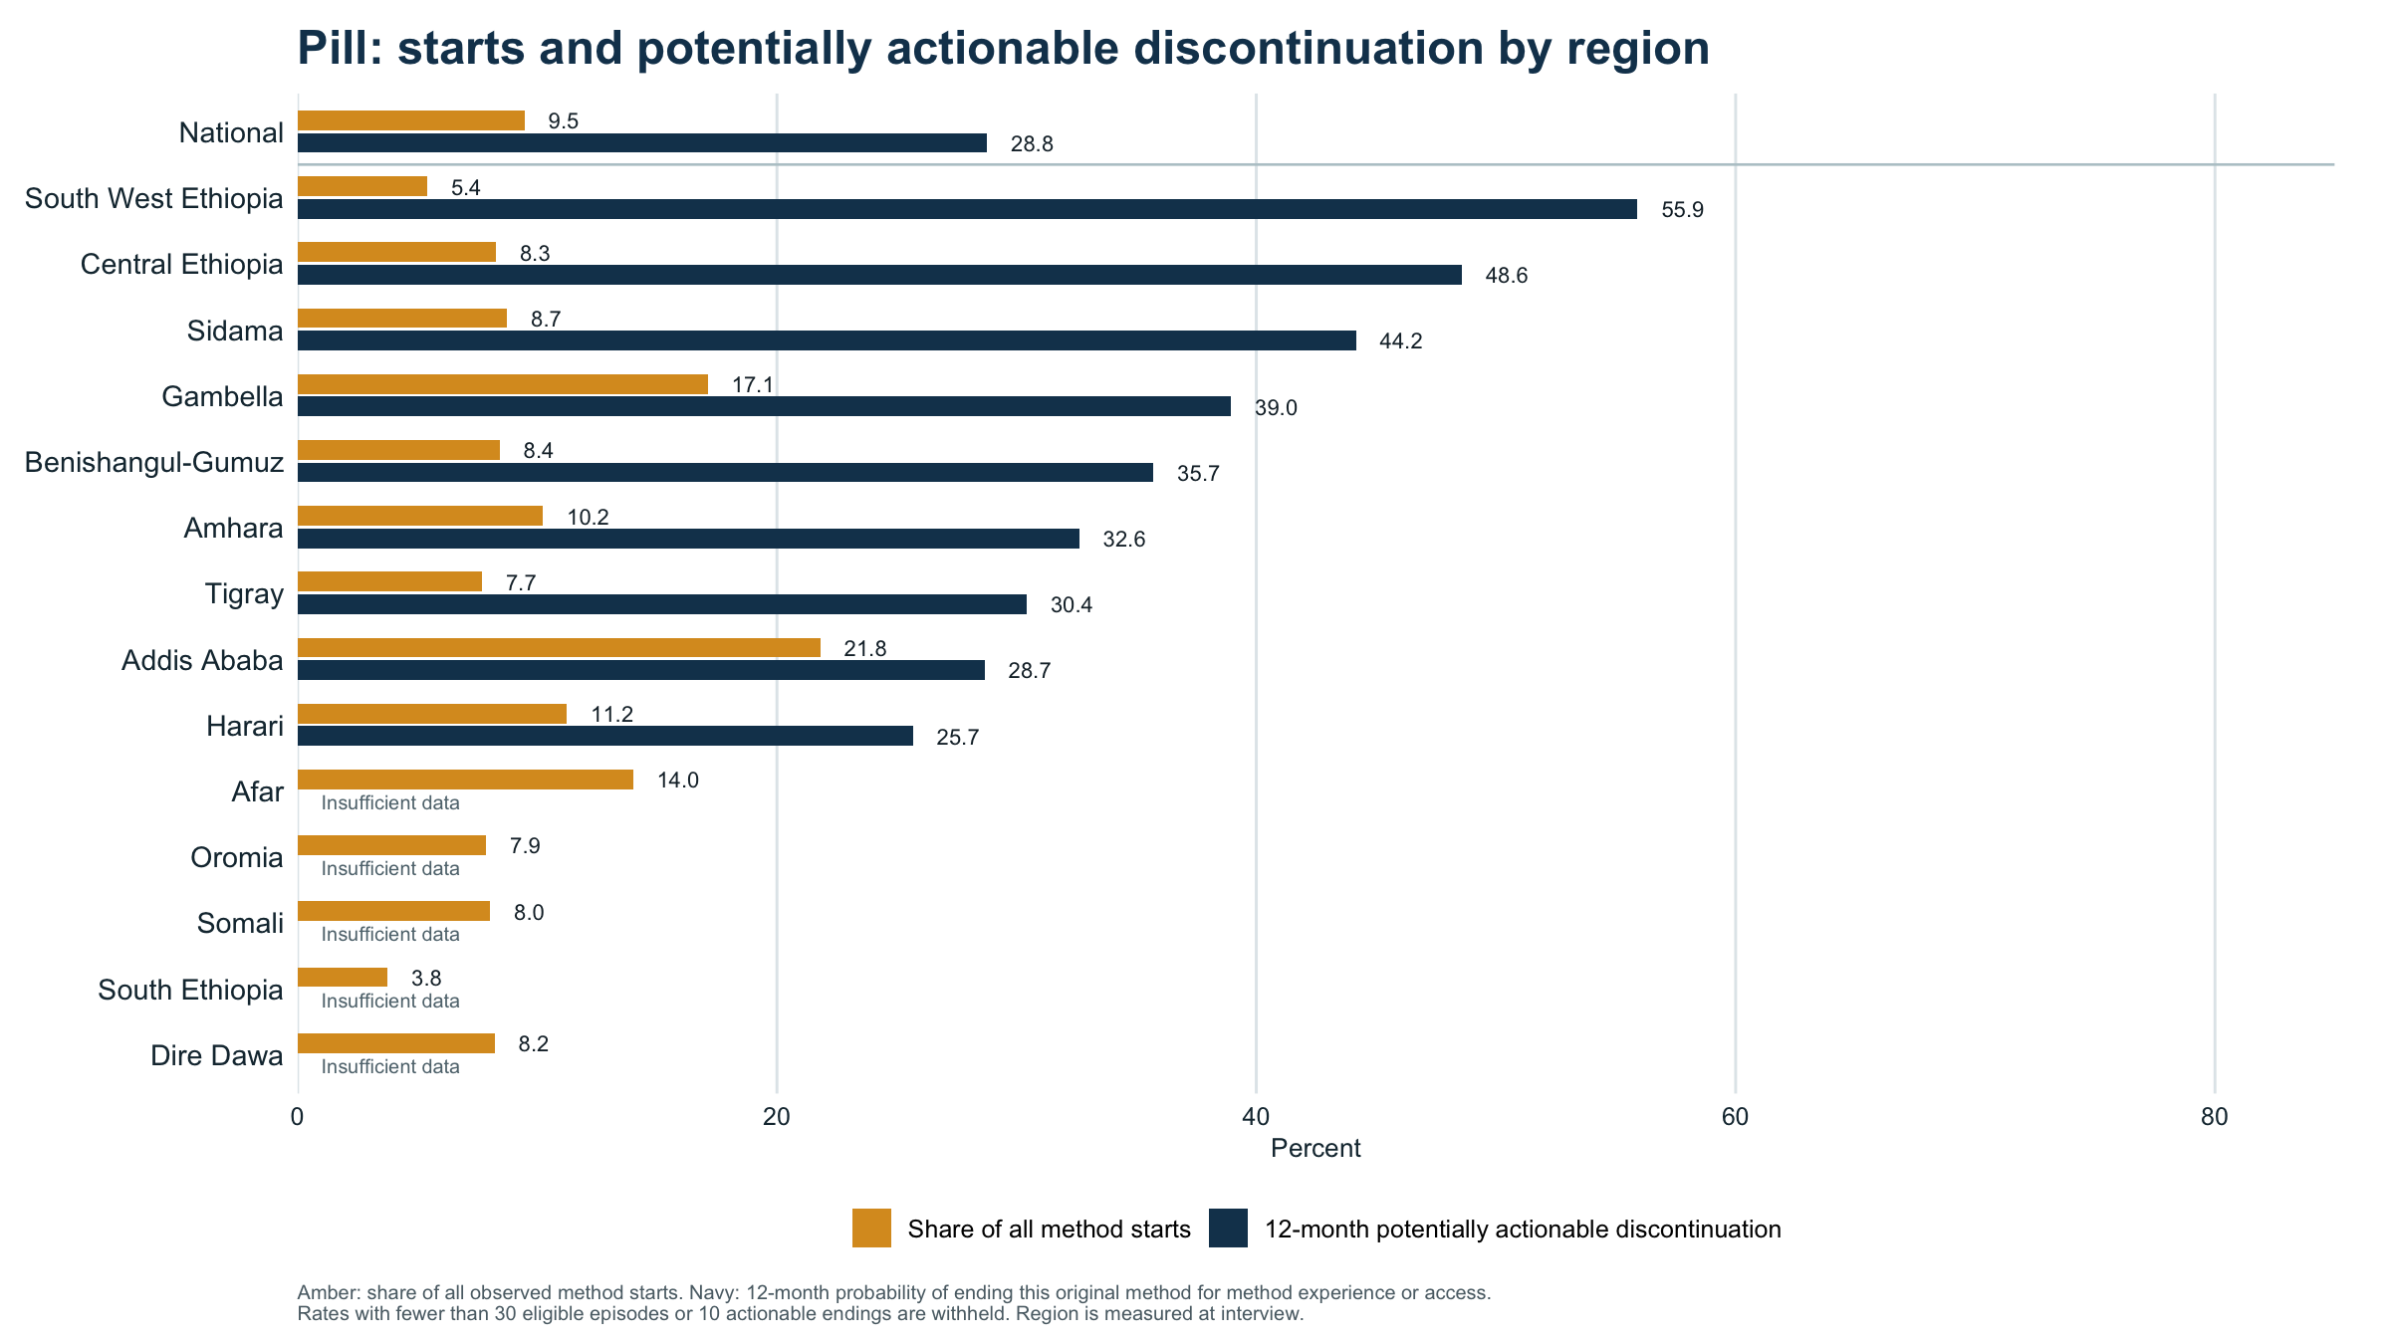

Slide 35
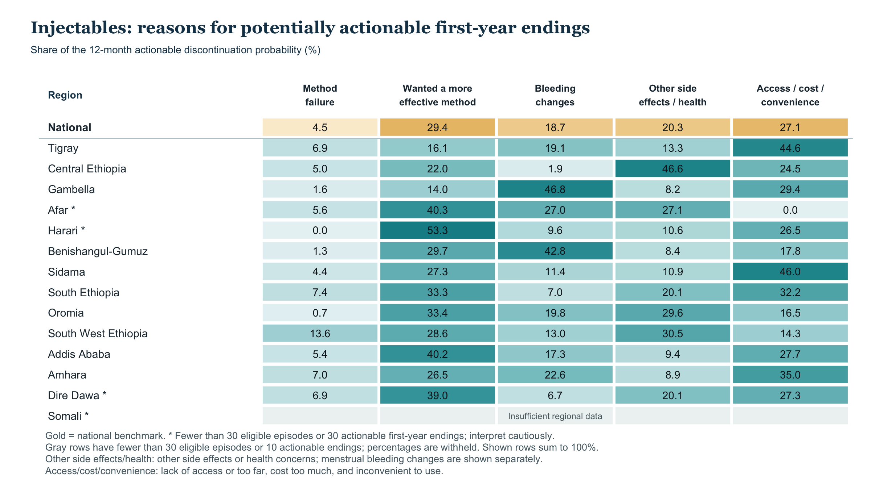

Slide 36
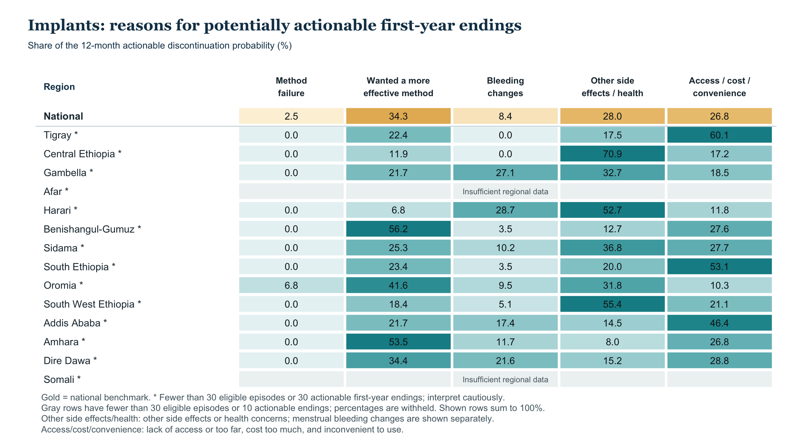

Slide 37
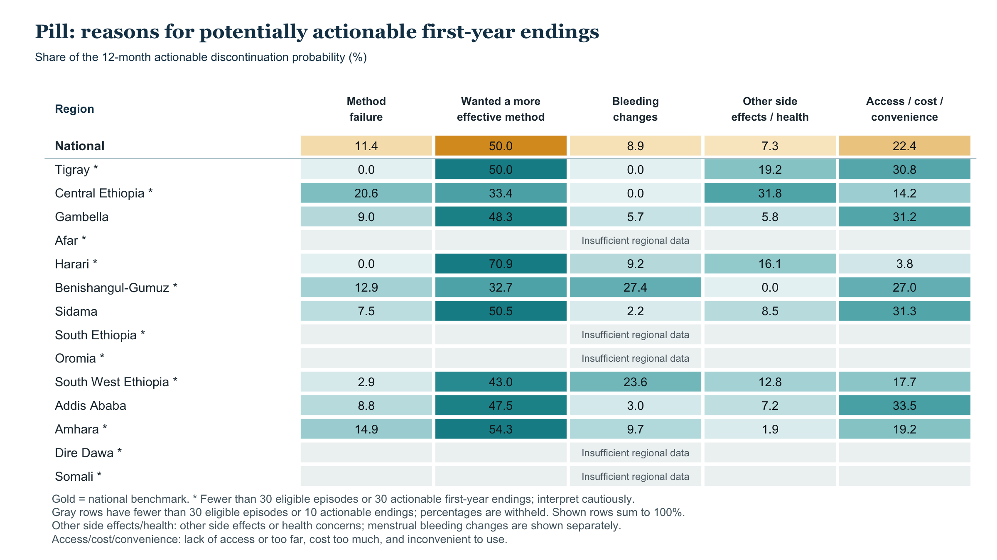

Slide 38
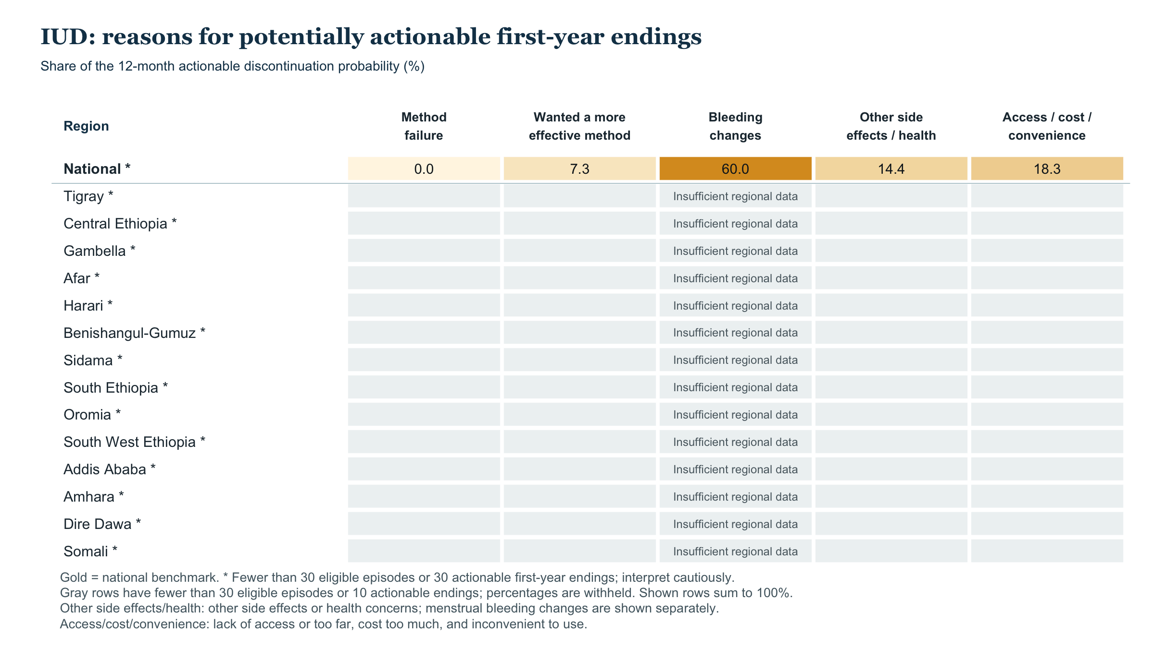

Slide 39
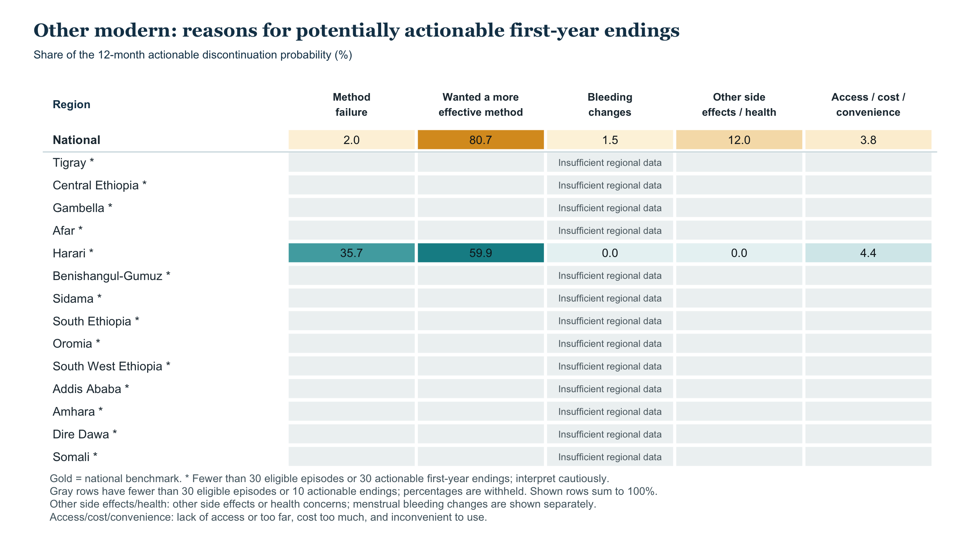

Slide 40
12-month discontinuation by region: potentially actionable reasons
Observed and fully adjusted probabilities (%) • 95% confidence intervals
Observed
Fully adjusted
OBSERVED
ADJUSTED
National
17.0%
17.2%
Tigray
23.6%
25.6%
Central Ethiopia
22.4%
24.5%
Gambella
21.5%
18.5%
Afar
20.0%
20.6%
Harari
19.7%
18.9%
Benishangul-Gumuz
18.5%
18.8%
Sidama
17.8%
18.7%
South Ethiopia
17.7%
18.3%
Oromia
17.2%
17.1%
South West Ethiopia
16.8%
17.7%
Addis Ababa
15.3%
14.2%
Amhara
15.1%
15.2%
Dire Dawa
14.7%
18.0%
Somali†
20.4%
21.1%
0
10
20
30
40
50
Actionable: failure, wanting greater effectiveness, bleeding/other health effects, or access/cost/convenience; other endings compete.
Model 2 adjusts for method, use month, region, age/parity at start, marital status, education, wealth, residence, and start year.
Observed n=8,611; adjusted reference n=7,648 starts. 95% CIs; adjusted: 1,000 PSU-bootstrap refits. † Somali: 30 episodes, 5 endings. CI overlap is not a regional test.

Slide 41
Regional discontinuation probabilities
12-month potentially actionable ending (%) • 95% confidence interval in parentheses
Region | Episodes (n) | Unadjusted | Model 1 | Model 2
National | 8,611 | 17.0% (15.1–19.0) | 17.1% (15.2–19.1) | 17.2% (15.0–19.3)
Tigray | 682 | 23.6% (20.4–26.8) | 24.9% (21.7–28.6) | 25.6% (22.2–29.7)
Central Ethiopia | 457 | 22.4% (17.9–26.9) | 24.5% (19.6–29.4) | 24.5% (19.0–29.7)
Afar | 194 | 20.0% (16.0–23.3) | 19.6% (14.7–24.2) | 20.6% (15.2–26.0)
Harari | 425 | 19.7% (15.6–24.1) | 19.1% (14.0–25.1) | 18.9% (13.9–24.8)
Benishangul-Gumuz | 652 | 18.5% (14.2–22.1) | 18.6% (14.7–21.7) | 18.8% (14.3–22.8)
Sidama | 1,155 | 17.8% (15.6–20.0) | 18.7% (16.1–21.5) | 18.7% (15.6–22.1)
Gambella | 548 | 21.5% (15.7–27.8) | 19.7% (14.6–25.2) | 18.5% (13.4–24.2)
Model 1: region, method, and months of use. Model 2 adds age, parity, marital status, education, wealth, residence, and start year.
Intervals: design-based (raw) and preliminary bootstrap (adjusted), including national estimates.
Raw rates use 8,611 eligible episodes; adjusted predictions use 7,648 episodes observed from method start.

Slide 42
Regional discontinuation probabilities (continued)
12-month potentially actionable ending (%) • 95% confidence interval in parentheses
Region | Episodes (n) | Unadjusted | Model 1 | Model 2
South Ethiopia | 644 | 17.7% (14.8–20.8) | 19.5% (16.5–23.5) | 18.3% (15.2–22.4)
Dire Dawa | 289 | 14.7% (10.1–19.4) | 17.8% (12.2–22.9) | 18.0% (12.0–24.6)
South West Ethiopia | 927 | 16.8% (13.7–19.9) | 17.8% (14.2–21.2) | 17.7% (14.0–21.0)
Oromia | 861 | 17.2% (12.5–22.2) | 17.3% (12.7–21.8) | 17.1% (12.3–21.8)
Amhara | 999 | 15.1% (12.2–17.8) | 14.8% (11.9–17.5) | 15.2% (12.2–18.2)
Addis Ababa | 748 | 15.3% (12.2–18.6) | 14.6% (11.4–18.2) | 14.2% (10.6–19.6)
Somali | 30 | 20.4% (0.0–49.1) | 20.6% (0.0–45.5) | 21.1% (0.0–51.1)
Model 1: region, method, and months of use. Model 2 adds age, parity, marital status, education, wealth, residence, and start year.
Intervals: design-based (raw) and preliminary bootstrap (adjusted), including national estimates.
Raw rates use 8,611 eligible episodes; adjusted predictions use 7,648 episodes observed from method start.

Slide 43
Two regional gaps remain with the same method and population mix
Potentially actionable 12-month discontinuation • 91 pairwise comparisons, Holm-corrected
2 of 91 regional pairs remain statistically different after full adjustment.
Overall regional test p=0.002. The chart shows only these pairs; all results remain in the working HTML.
Tigray vs Amhara
+10.3 pp
25.6% vs 15.2%
Holm p=0.001
Tigray vs Addis Ababa
+11.3 pp
25.6% vs 14.2%
Holm p=0.005
0
5
10
15
20
25
Adjusted difference in 12-month probability (percentage points)
Gold whiskers: conservative 95% familywise Bonferroni intervals for 91 contrasts; p-values use Holm correction.
Differences use the same survey-stratified PSU bootstrap refit for both regions; 1,000 full-model refits.
Somali (30 episodes, 5 selected endings) is too sparse to interpret as a ranked contrast. Regional associations are not causal effects.

Slide 44
Regional gaps change when regions have the same method mix
Potentially actionable 12-month discontinuation, three pairs passing Holm correction across 91 comparisons
Each region’s own method mix
Same mix within this pair, with 95% CI
OWN MIX
SAME MIX
Tigray vs Amhara
Holm p=<0.001
8.4 pp
10.2 pp
Tigray vs Addis Ababa
Holm p=0.005
8.4 pp
10.0 pp
Central Ethiopia vs Amhara
Holm p=0.044
7.3 pp
9.7 pp
0
4
8
12
16
Gap in 12-month probability (percentage points)
Same mix: average of each pair’s weighted method-start shares; each region keeps its fitted risk within each method.
Model 1 includes region, method, and month of use. It excludes EC and uses 8,611 eligible episodes; mix uses 7,648 observed starts.
Gold whiskers are pointwise 95% bootstrap intervals. Holm p-values adjust 91 tests; the fitted gaps do not decompose raw life-table gaps.

Slide 45
Regional gaps: observed, same method mix, same method and population mix
12-month discontinuation due to potentially actionable reasons · gap in percentage points
Observed
Same method mix
Fully adjusted
Tigray vs Amhara
8.5
10.2
10.3
Tigray vs Addis Ababa
8.3
10.0
11.3
Central Ethiopia vs Amhara
7.3
9.7
9.3
0
5
10
15
0
5
10
15
0
5
10
15
Difference in 12-month probability (percentage points)
Filled dots: Holm p < 0.05 across 91 pairs. Lines: pointwise 95% survey-bootstrap intervals.
Same method mix: each pair’s average method-start mix. Fully adjusted: one common observed-start profile.
8,611 EC-excluded episodes. These panels do not form an exact decomposition of the observed gap.

Slide 46
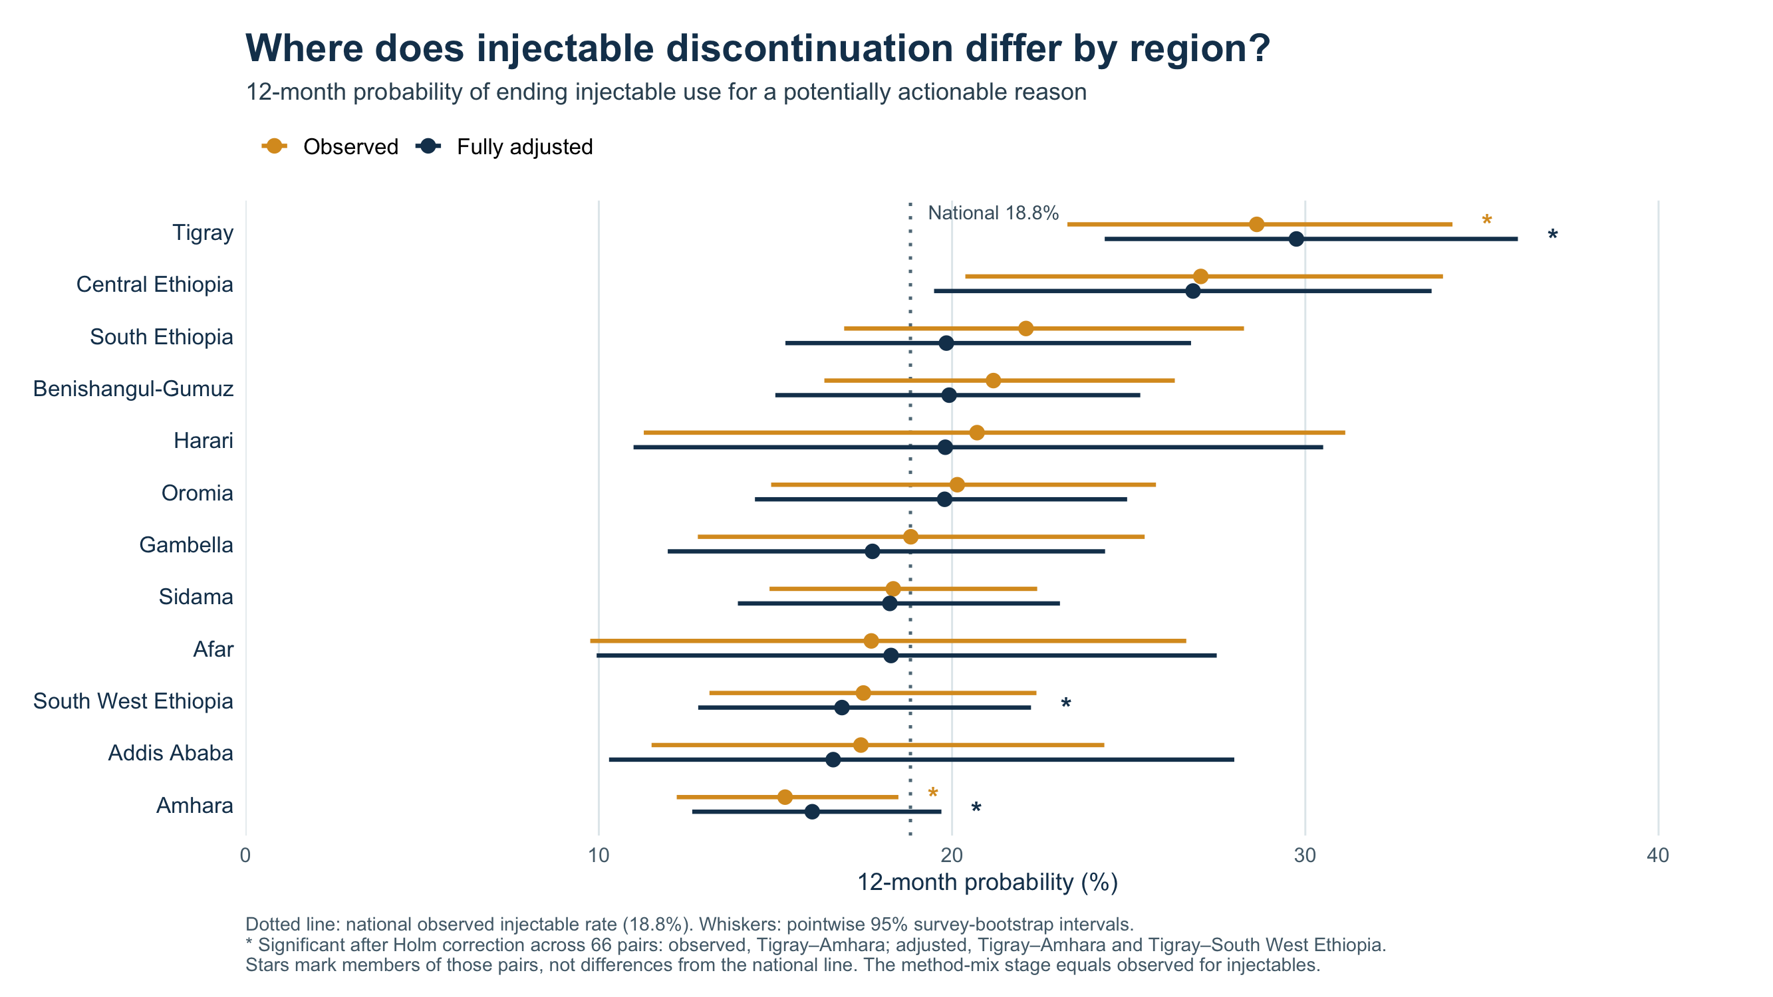

Slide 47
Illustrative 12-month method endings for actionable causes
Women aged 15–49: 34.06 million mCPR: 22.7% Current modern users: 7.74 million
Method | Current mix (%) | Current users | 12-month actionable risk (%) | Estimated original- method endings
Injectables | 57.5 | 4,454,518 | 18.8 | 838,423
Implants | 29.6 | 2,288,361 | 8.2 | 187,770
Pill | 7.1 | 547,385 | 28.8 | 157,503
IUD | 2.5 | 190,185 | 14.0 | 26,578
Other modern methods | 2.5 | 194,218 | 16.2 | 31,419
EC | 0.9 | 66,169 | Not applied | Not estimated
Current-user mix total, excluding EC | 99.1 | 7,674,667 | 16.2 | 1,241,693
Method-specific first-year 12-month life-table risks for actionable original-method endings are applied to current users; this ignores time already used, and switches still count as endings. Total 16.2% is current-user weighted (episode rate: 17.0%).

Slide 48
Current users ending each method for actionable reasons
Illustrative original-method endings from the current users on slide 47
Method | Current users | Method failure | Wanted more effective | Bleeding changes | Other side effects / health | Access / cost / convenience | Total actionable endings
Injectables | 4,454,518 | 37,954 | 246,033 | 156,676 | 170,349 | 227,411 | 838,423
Implants | 2,288,361 | 4,572 | 64,452 | 15,778 | 52,639 | 50,329 | 187,770
Pill | 547,385 | 17,918 | 78,808 | 14,022 | 11,432 | 35,323 | 157,503
IUD | 190,185 | 0 | 1,949 | 15,938 | 3,814 | 4,876 | 26,578
Other modern methods | 194,218 | 629 | 25,351 | 479 | 3,753 | 1,207 | 31,419
All methods, excluding EC | 7,674,667 | 61,072 | 416,594 | 202,895 | 241,987 | 319,145 | 1,241,693
Each cause count = current users of the method × its cause-specific 12-month life-table probability. Counts use unrounded inputs.
The total column matches slide 47. Switching counts as ending the original method; this is an illustration, not a next-year forecast.

Slide 49
2026 mCPR scenarios share the same DHS baseline
2025 women aged 15–49: 34.06 million Current modern users: 7.74 million
Scenario | 2025 DHS mCPR | Change to 2026 | Illustrative 2026 mCPR
Status quo | 22.73% | 0 pp | 22.73%
UN annual change | 22.73% | +0.8 pp | 23.53%
Track20/FP2030 recent change | 22.73% | +0.7 pp | 23.43%
UN: 28.5% in 2026 minus 27.7% in 2025. Track20/FP2030: recent +0.7-point annual change extrapolated to 2026.
All scenarios start from the unrounded 2024–25 DHS all-women mCPR (22.7287%); modeled source levels are not used as the baseline.

Slide 50
Illustrative mCPR gain if actionable method endings are avoided
2025: 34.06 million women; 7.74 million modern users 2026: 35.02 million women aged 15–49
Different mCPR growth scenarios | 2026 users, usual endings | 2026 mCPR | 2026 users if retained | Revised 2026 mCPR | Difference
Status quo | 7,958,717 | 22.73% | 9,200,410 | 26.27% | +3.55 pp
UN annual change | 8,238,846 | 23.53% | 9,480,539 | 27.07% | +3.55 pp
Track20/FP2030 | 8,203,830 | 23.43% | 9,445,523 | 26.97% | +3.55 pp
1,241,693 additional modern users ÷ 35,016,171 women aged 15–49 = +3.55 percentage points.
Upper-bound illustration: the 1,241,693 are projected original-method endings among 2025 users; some women would switch or restart.

Slide 51
No-growth scenario: users and mCPR by method
No change from the 2025 DHS all-women mCPR
Method | 2025 users | 2026 users | Endings averted | 2026 if averted | 2026 mCPR | mCPR if averted
Injectables | 4,454,518 | 4,579,899 | 838,423 | 5,418,323 | 13.08% | 15.47%
Implants | 2,288,361 | 2,352,772 | 187,770 | 2,540,542 | 6.72% | 7.26%
Pill | 547,385 | 562,793 | 157,503 | 720,296 | 1.61% | 2.06%
IUD | 190,185 | 195,538 | 26,578 | 222,115 | 0.56% | 0.63%
Other modern | 194,218 | 199,684 | 31,419 | 231,103 | 0.57% | 0.66%
EC | 66,169 | 68,031 | — | 68,031 | 0.19% | 0.19%
All modern | 7,740,836 | 7,958,717 | 1,241,693 | 9,200,410 | 22.73% | 26.27%
Each method’s mCPR is its users ÷ 35,016,171 women aged 15–49; the total row is all-modern mCPR.
Only potentially actionable original-method endings are averted here. Upper-bound illustration: some women would switch or restart.

Slide 52
UN-growth scenario: users and mCPR by method
+0.8 percentage points applied to the 2025 DHS mCPR
Method | 2025 users | 2026 users | Endings averted | 2026 if averted | 2026 mCPR | mCPR if averted
Injectables | 4,454,518 | 4,741,102 | 838,423 | 5,579,525 | 13.54% | 15.93%
Implants | 2,288,361 | 2,435,584 | 187,770 | 2,623,354 | 6.96% | 7.49%
Pill | 547,385 | 582,602 | 157,503 | 740,105 | 1.66% | 2.11%
IUD | 190,185 | 202,420 | 26,578 | 228,998 | 0.58% | 0.65%
Other modern | 194,218 | 206,713 | 31,419 | 238,132 | 0.59% | 0.68%
EC | 66,169 | 70,426 | — | 70,426 | 0.20% | 0.20%
All modern | 7,740,836 | 8,238,846 | 1,241,693 | 9,480,539 | 23.53% | 27.07%
Each method’s mCPR is its users ÷ 35,016,171 women aged 15–49; the total row is all-modern mCPR.
Only potentially actionable original-method endings are averted here. Upper-bound illustration: some women would switch or restart.

Slide 53
Track20-growth scenario: users and mCPR by method
+0.7 percentage points applied to the 2025 DHS mCPR
Method | 2025 users | 2026 users | Endings averted | 2026 if averted | 2026 mCPR | mCPR if averted
Injectables | 4,454,518 | 4,720,951 | 838,423 | 5,559,375 | 13.48% | 15.88%
Implants | 2,288,361 | 2,425,233 | 187,770 | 2,613,003 | 6.93% | 7.46%
Pill | 547,385 | 580,126 | 157,503 | 737,629 | 1.66% | 2.11%
IUD | 190,185 | 201,560 | 26,578 | 228,137 | 0.58% | 0.65%
Other modern | 194,218 | 205,834 | 31,419 | 237,253 | 0.59% | 0.68%
EC | 66,169 | 70,126 | — | 70,126 | 0.20% | 0.20%
All modern | 7,740,836 | 8,203,830 | 1,241,693 | 9,445,523 | 23.43% | 26.97%
Each method’s mCPR is its users ÷ 35,016,171 women aged 15–49; the total row is all-modern mCPR.
Only potentially actionable original-method endings are averted here. Upper-bound illustration: some women would switch or restart.

Slide 54
Potential mCPR gain differs by actionable cause of method ending
Ethiopia | illustrative gross ceiling using 2025 current users and 2026 women aged 15–49
Method / measure | Method failure | Want more effective | Bleeding changes | Other side effects / health | Access / cost / convenience | All actionable causes
Injectables | 37,954 | 246,033 | 156,676 | 170,349 | 227,411 | 838,423
Implants | 4,572 | 64,452 | 15,778 | 52,639 | 50,329 | 187,770
Pill | 17,918 | 78,808 | 14,022 | 11,432 | 35,323 | 157,503
IUD | 0 | 1,949 | 15,938 | 3,814 | 4,876 | 26,578
Other modern | 629 | 25,351 | 479 | 3,753 | 1,207 | 31,419
Estimated users ending method | 61,072 | 416,594 | 202,895 | 241,987 | 319,145 | 1,241,693
2026 women aged 15–49 | 35,016,171 | 35,016,171 | 35,016,171 | 35,016,171 | 35,016,171 | 35,016,171
Maximum mCPR increase | 0.17 pp | 1.19 pp | 0.58 pp | 0.69 pp | 0.91 pp | 3.55 pp
Each cause: estimated original-method endings ÷ 35,016,171 women aged 15–49 in 2026.
Gross upper bounds, not expected program effects: women may switch to another modern method or restart; current-user duration is not modeled.
Ethiopia DHS 2024–25 IR analysis; 2026 women aged 15–49 projection; existing method-by-cause current-user projection.

Slide 55
Historical duration-aware: actionable endings
2025 current users; next 12 months conditional on time already used
Method | Current mix (%) | Current users | Actionable ending risk (%) | Nonmodern at year end
Injectables | 57.5 | 4,454,518 | 11.9 | 346,518
Implants | 29.6 | 2,288,361 | 11.2 | 175,978
Pill | 7.1 | 547,385 | 21.3 | 76,381
IUD | 2.5 | 190,185 | 8.4 | 12,772
Other modern methods | 2.5 | 194,218 | 11.1 | 9,052
EC | 0.9 | 66,169 | Not applied | Not estimated
Current-user mix total, excluding EC | 99.1 | 7,674,667 | 12.3 | 620,701
Ending risk: weighted 12-month actionable ending probability from historical calendar landmarks, matched by method and elapsed-use band; other endings compete. The 61+ month group uses the 37–60-month risk. Year-end counts account for observed switching/restarting; EC excluded.

Slide 56
Historical duration-aware: year-end loss by cause
Projected current users; 620,701 nonmodern at year end after actionable endings
Method | Current users | Method failure | Wanted more effective | Bleeding changes | Other side effects health | Access / cost / convenience | Nonmodern at year end
Injectables | 4,454,518 | 29,228 | 75,555 | 69,432 | 82,449 | 89,853 | 346,518
Implants | 2,288,361 | 4,518 | 54,203 | 18,190 | 47,957 | 51,110 | 175,978
Pill | 547,385 | 26,739 | 22,364 | 6,881 | 7,313 | 13,084 | 76,381
IUD | 190,185 | 18 | 6,492 | 4,492 | 638 | 1,131 | 12,772
Other modern methods | 194,218 | 1,077 | 4,838 | 1,126 | 1,511 | 500 | 9,052
All methods, excluding EC | 7,674,667 | 61,580 | 163,452 | 100,122 | 139,868 | 155,679 | 620,701
Each cause count uses current users × the method- and cause-specific year-end nonmodern probability.
Cause probability: share of matched historical method-duration landmarks ending for that actionable reason and not using a modern method at month 12. Applied to the current-user method-duration mix.

Slide 57
Historical duration-aware: common 2026 mCPR baselines
2025 women aged 15–49: 34.06 million Current modern users: 7.74 million
Scenario | 2025 DHS mCPR | Change to 2026 | Illustrative 2026 mCPR
Status quo | 22.73% | 0 pp | 22.73%
UN annual change | 22.73% | +0.8 pp | 23.53%
Track20/FP2030 recent change | 22.73% | +0.7 pp | 23.43%
UN: 28.5% in 2026 minus 27.7% in 2025. Track20/FP2030: recent +0.7-point annual change extrapolated to 2026.
All scenarios use the same unrounded DHS 2024–25 all-women mCPR baseline (22.7287%).

Slide 58
Historical duration-aware: mCPR if year-end loss avoided
2026 women aged 15–49: 35.02 million Year-end nonmodern after actionable endings
Different mCPR growth scenarios | 2026 users, usual endings | 2026 mCPR | 2026 users if retained | Revised 2026 mCPR | Difference
Status quo | 7,958,717 | 22.73% | 8,579,418 | 24.50% | +1.77 pp
UN annual change | 8,238,846 | 23.53% | 8,859,547 | 25.30% | +1.77 pp
Track20/FP2030 | 8,203,830 | 23.43% | 8,824,531 | 25.20% | +1.77 pp
620,701 ÷ 35,016,171 projected 2026 women aged 15–49 = +1.77 pp.
942,904 projected actionable original-method endings; 620,701 are nonmodern at year end after observed switching/restarting pathways.

Slide 59
Historical duration-aware: no-growth mCPR by method
No change from the 2025 DHS all-women mCPR
Method | 2025 users | 2026 users | Year-end loss averted | 2026 if averted | 2026 mCPR | mCPR if averted
Injectables | 4,454,518 | 4,579,899 | 346,518 | 4,926,417 | 13.08% | 14.07%
Implants | 2,288,361 | 2,352,772 | 175,978 | 2,528,750 | 6.72% | 7.22%
Pill | 547,385 | 562,793 | 76,381 | 639,174 | 1.61% | 1.83%
IUD | 190,185 | 195,538 | 12,772 | 208,310 | 0.56% | 0.59%
Other modern | 194,218 | 199,684 | 9,052 | 208,736 | 0.57% | 0.60%
EC | 66,169 | 68,031 | — | 68,031 | 0.19% | 0.19%
All modern | 7,740,836 | 7,958,717 | 620,701 | 8,579,418 | 22.73% | 24.50%
Each method’s mCPR = method users ÷ 35,016,171 projected 2026 women aged 15–49.
Year-end loss averted: current users × historical method-duration probability of an actionable ending followed by no modern use at month 12 (620,701 total).

Slide 60
Historical duration-aware: UN-growth mCPR by method
+0.8 percentage points applied to the 2025 DHS mCPR
Method | 2025 users | 2026 users | Year-end loss averted | 2026 if averted | 2026 mCPR | mCPR if averted
Injectables | 4,454,518 | 4,741,102 | 346,518 | 5,087,619 | 13.54% | 14.53%
Implants | 2,288,361 | 2,435,584 | 175,978 | 2,611,562 | 6.96% | 7.46%
Pill | 547,385 | 582,602 | 76,381 | 658,983 | 1.66% | 1.88%
IUD | 190,185 | 202,420 | 12,772 | 215,193 | 0.58% | 0.61%
Other modern | 194,218 | 206,713 | 9,052 | 215,765 | 0.59% | 0.62%
EC | 66,169 | 70,426 | — | 70,426 | 0.20% | 0.20%
All modern | 7,740,836 | 8,238,846 | 620,701 | 8,859,547 | 23.53% | 25.30%
Each method’s mCPR = method users ÷ 35,016,171 projected 2026 women aged 15–49.
Year-end loss averted: current users × historical method-duration probability of an actionable ending followed by no modern use at month 12 (620,701 total).

Slide 61
Historical duration-aware: Track20-growth mCPR by method
+0.7 percentage points applied to the 2025 DHS mCPR
Method | 2025 users | 2026 users | Year-end loss averted | 2026 if averted | 2026 mCPR | mCPR if averted
Injectables | 4,454,518 | 4,720,951 | 346,518 | 5,067,469 | 13.48% | 14.47%
Implants | 2,288,361 | 2,425,233 | 175,978 | 2,601,210 | 6.93% | 7.43%
Pill | 547,385 | 580,126 | 76,381 | 656,507 | 1.66% | 1.87%
IUD | 190,185 | 201,560 | 12,772 | 214,332 | 0.58% | 0.61%
Other modern | 194,218 | 205,834 | 9,052 | 214,886 | 0.59% | 0.61%
EC | 66,169 | 70,126 | — | 70,126 | 0.20% | 0.20%
All modern | 7,740,836 | 8,203,830 | 620,701 | 8,824,531 | 23.43% | 25.20%
Each method’s mCPR = method users ÷ 35,016,171 projected 2026 women aged 15–49.
Year-end loss averted: current users × historical method-duration probability of an actionable ending followed by no modern use at month 12 (620,701 total).

Slide 62
Historical duration-aware: mCPR equivalent by actionable cause
Ethiopia | year-end nonmodern users after actionable original-method endings
Method measure | Method failure | Want more effective | Bleeding changes | Other side effects health | Access / cost / convenience | All actionable causes
Injectables | 29,228 | 75,555 | 69,432 | 82,449 | 89,853 | 346,518
Implants | 4,518 | 54,203 | 18,190 | 47,957 | 51,110 | 175,978
Pill | 26,739 | 22,364 | 6,881 | 7,313 | 13,084 | 76,381
IUD | 18 | 6,492 | 4,492 | 638 | 1,131 | 12,772
Other modern | 1,077 | 4,838 | 1,126 | 1,511 | 500 | 9,052
Estimated nonmodern at year end | 61,580 | 163,452 | 100,122 | 139,868 | 155,679 | 620,701
2026 women aged 15–49 | 35,016,171 | 35,016,171 | 35,016,171 | 35,016,171 | 35,016,171 | 35,016,171
Maximum mCPR equivalent | 0.18 pp | 0.47 pp | 0.29 pp | 0.40 pp | 0.44 pp | 1.77 pp
Each cause: projected year-end nonmodern users ÷ 35,016,171 projected 2026 women aged 15–49.
Potential mCPR-equivalent ceiling is 1.77 pp. Switching and restarting are reflected in the year-end counts; this is not a predicted program effect.
Cause probability: share of matched historical method-duration landmarks ending for that actionable reason and not using a modern method at month 12. Applied to the current-user method-duration mix.

Slide 63
AFT + pathways: actionable endings
2025 current users; next 12 months conditional on time already used
Method | Current mix (%) | Current users | Actionable ending risk (%) | Nonmodern at year end
Injectables | 57.5 | 4,454,518 | 14.0 | 399,671
Implants | 29.6 | 2,288,361 | 8.3 | 130,706
Pill | 7.1 | 547,385 | 23.7 | 79,957
IUD | 2.5 | 190,185 | 10.4 | 15,416
Other modern methods | 2.5 | 194,218 | 13.3 | 9,471
EC | 0.9 | 66,169 | Not applied | Not estimated
Current-user mix total, excluding EC | 99.1 | 7,674,667 | 12.9 | 635,221
Ending risk: two survey-weighted, method-only AFT models estimate actionable and other-ending hazards. The 12-month actionable probability is conditional on months already used. Year-end counts add observed switching/restarting pathways; EC excluded.

Slide 64
AFT + pathways: year-end loss by cause
Projected current users; 635,221 nonmodern at year end after actionable endings
Method | Current users | Method failure | Wanted more effective | Bleeding changes | Other side effects health | Access / cost / convenience | Nonmodern at year end
Injectables | 4,454,518 | 31,018 | 85,331 | 86,603 | 86,476 | 110,243 | 399,671
Implants | 2,288,361 | 2,968 | 35,531 | 16,248 | 37,286 | 38,675 | 130,706
Pill | 547,385 | 13,807 | 31,765 | 10,162 | 6,633 | 17,589 | 79,957
IUD | 190,185 | 34 | 5,047 | 6,697 | 1,733 | 1,905 | 15,416
Other modern methods | 194,218 | 739 | 4,255 | 405 | 2,782 | 1,290 | 9,471
All methods, excluding EC | 7,674,667 | 48,565 | 161,928 | 120,115 | 134,909 | 169,703 | 635,221
Each cause count uses current users × the method- and cause-specific year-end nonmodern probability.
Cause probability: cause-specific AFT patterns allocate the actionable ending risk across five reasons. The year-end nonmodern probability then applies observed switching/restarting pathways by method, duration and cause.

Slide 65
AFT + pathways: common 2026 mCPR baselines
2025 women aged 15–49: 34.06 million Current modern users: 7.74 million
Scenario | 2025 DHS mCPR | Change to 2026 | Illustrative 2026 mCPR
Status quo | 22.73% | 0 pp | 22.73%
UN annual change | 22.73% | +0.8 pp | 23.53%
Track20/FP2030 recent change | 22.73% | +0.7 pp | 23.43%
UN: 28.5% in 2026 minus 27.7% in 2025. Track20/FP2030: recent +0.7-point annual change extrapolated to 2026.
All scenarios use the same unrounded DHS 2024–25 all-women mCPR baseline (22.7287%).

Slide 66
AFT + pathways: mCPR if year-end loss avoided
2026 women aged 15–49: 35.02 million Year-end nonmodern after actionable endings
Different mCPR growth scenarios | 2026 users, usual endings | 2026 mCPR | 2026 users if retained | Revised 2026 mCPR | Difference
Status quo | 7,958,717 | 22.73% | 8,593,937 | 24.54% | +1.81 pp
UN annual change | 8,238,846 | 23.53% | 8,874,066 | 25.34% | +1.81 pp
Track20/FP2030 | 8,203,830 | 23.43% | 8,839,050 | 25.24% | +1.81 pp
635,221 ÷ 35,016,171 projected 2026 women aged 15–49 = +1.81 pp.
986,440 projected actionable original-method endings; 635,221 are nonmodern at year end after observed switching/restarting pathways.

Slide 67
AFT + pathways: no-growth mCPR by method
No change from the 2025 DHS all-women mCPR
Method | 2025 users | 2026 users | Year-end loss averted | 2026 if averted | 2026 mCPR | mCPR if averted
Injectables | 4,454,518 | 4,579,899 | 399,671 | 4,979,570 | 13.08% | 14.22%
Implants | 2,288,361 | 2,352,772 | 130,706 | 2,483,478 | 6.72% | 7.09%
Pill | 547,385 | 562,793 | 79,957 | 642,749 | 1.61% | 1.84%
IUD | 190,185 | 195,538 | 15,416 | 210,954 | 0.56% | 0.60%
Other modern | 194,218 | 199,684 | 9,471 | 209,155 | 0.57% | 0.60%
EC | 66,169 | 68,031 | — | 68,031 | 0.19% | 0.19%
All modern | 7,740,836 | 7,958,717 | 635,221 | 8,593,937 | 22.73% | 24.54%
Each method’s mCPR = method users ÷ 35,016,171 projected 2026 women aged 15–49.
Year-end loss averted: current users × AFT actionable ending probability conditional on elapsed use × observed chance of no modern use at month 12 (635,221 total).

Slide 68
AFT + pathways: UN-growth mCPR by method
+0.8 percentage points applied to the 2025 DHS mCPR
Method | 2025 users | 2026 users | Year-end loss averted | 2026 if averted | 2026 mCPR | mCPR if averted
Injectables | 4,454,518 | 4,741,102 | 399,671 | 5,140,772 | 13.54% | 14.68%
Implants | 2,288,361 | 2,435,584 | 130,706 | 2,566,291 | 6.96% | 7.33%
Pill | 547,385 | 582,602 | 79,957 | 662,558 | 1.66% | 1.89%
IUD | 190,185 | 202,420 | 15,416 | 217,836 | 0.58% | 0.62%
Other modern | 194,218 | 206,713 | 9,471 | 216,183 | 0.59% | 0.62%
EC | 66,169 | 70,426 | — | 70,426 | 0.20% | 0.20%
All modern | 7,740,836 | 8,238,846 | 635,221 | 8,874,066 | 23.53% | 25.34%
Each method’s mCPR = method users ÷ 35,016,171 projected 2026 women aged 15–49.
Year-end loss averted: current users × AFT actionable ending probability conditional on elapsed use × observed chance of no modern use at month 12 (635,221 total).

Slide 69
AFT + pathways: Track20-growth mCPR by method
+0.7 percentage points applied to the 2025 DHS mCPR
Method | 2025 users | 2026 users | Year-end loss averted | 2026 if averted | 2026 mCPR | mCPR if averted
Injectables | 4,454,518 | 4,720,951 | 399,671 | 5,120,622 | 13.48% | 14.62%
Implants | 2,288,361 | 2,425,233 | 130,706 | 2,555,939 | 6.93% | 7.30%
Pill | 547,385 | 580,126 | 79,957 | 660,082 | 1.66% | 1.89%
IUD | 190,185 | 201,560 | 15,416 | 216,976 | 0.58% | 0.62%
Other modern | 194,218 | 205,834 | 9,471 | 215,305 | 0.59% | 0.61%
EC | 66,169 | 70,126 | — | 70,126 | 0.20% | 0.20%
All modern | 7,740,836 | 8,203,830 | 635,221 | 8,839,050 | 23.43% | 25.24%
Each method’s mCPR = method users ÷ 35,016,171 projected 2026 women aged 15–49.
Year-end loss averted: current users × AFT actionable ending probability conditional on elapsed use × observed chance of no modern use at month 12 (635,221 total).

Slide 70
AFT + pathways: mCPR equivalent by actionable cause
Ethiopia | year-end nonmodern users after actionable original-method endings
Method measure | Method failure | Want more effective | Bleeding changes | Other side effects health | Access / cost / convenience | All actionable causes
Injectables | 31,018 | 85,331 | 86,603 | 86,476 | 110,243 | 399,671
Implants | 2,968 | 35,531 | 16,248 | 37,286 | 38,675 | 130,706
Pill | 13,807 | 31,765 | 10,162 | 6,633 | 17,589 | 79,957
IUD | 34 | 5,047 | 6,697 | 1,733 | 1,905 | 15,416
Other modern | 739 | 4,255 | 405 | 2,782 | 1,290 | 9,471
Estimated nonmodern at year end | 48,565 | 161,928 | 120,115 | 134,909 | 169,703 | 635,221
2026 women aged 15–49 | 35,016,171 | 35,016,171 | 35,016,171 | 35,016,171 | 35,016,171 | 35,016,171
Maximum mCPR equivalent | 0.14 pp | 0.46 pp | 0.34 pp | 0.39 pp | 0.48 pp | 1.81 pp
Each cause: projected year-end nonmodern users ÷ 35,016,171 projected 2026 women aged 15–49.
Potential mCPR-equivalent ceiling is 1.81 pp. Switching and restarting are reflected in the year-end counts; this is not a predicted program effect.
Cause probability: cause-specific AFT patterns allocate the actionable ending risk across five reasons. The year-end nonmodern probability then applies observed switching/restarting pathways by method, duration and cause.

Slide 71
Appendix: earlier duration-aware analyses
The following slides retain the previous historical and AFT analyses, including original-method endings and exploratory switching pathways.

Slide 72
Current users face risks conditional on time already used
Historical method-and-duration landmarks predict the next 12 months from current use
Current method | 2025 users | Actionable ending next year | Direct modern switch | Modern at year end | Nonmodern at year end | 61+ months used
Injectables | 4,454,518 | 532,177 | 122,047 | 185,659 | 346,518 | 8.1%
Implants | 2,288,361 | 256,335 | 65,337 | 80,357 | 175,978 | 4.5%
Pill | 547,385 | 116,836 | 28,574 | 40,455 | 76,381 | 3.9%
IUD | 190,185 | 16,046 | 1,735 | 3,274 | 12,772 | 23.3%
Other modern | 194,218 | 21,509 | 10,794 | 12,457 | 9,052 | 20.9%
EC | 66,169 | — | — | — | — | —
All modern | 7,740,836 | 942,904 | 228,487 | 322,203 | 620,701 | —
Year-end modern use includes direct switching and later restarting. “Nonmodern” follows an actionable ending; it is an observed-pathway analogue, not a causal estimate of retention.
Ethiopia DHS calendar analysis; survey-weighted retrospective estimates. Planning stock: 2025 users; pp denominator: 35.02 million women.

Slide 73
Actionable reasons behind nonmodern use at year end
Duration-standardized projections for the next 12 months, by current method
Current method | Failure | More effective | Bleeding | Other health | Access / cost | Total
Injectables | 29,228 | 75,555 | 69,432 | 82,449 | 89,853 | 346,518
Implants | 4,518 | 54,203 | 18,190 | 47,957 | 51,110 | 175,978
Pill | 26,739 | 22,364 | 6,881 | 7,313 | 13,084 | 76,381
IUD | 18 | 6,492 | 4,492 | 638 | 1,131 | 12,772
Other modern | 1,077 | 4,838 | 1,126 | 1,511 | 500 | 9,052
All methods | 61,580 | 163,452 | 100,122 | 139,868 | 155,679 | 620,701
Each cell follows an actionable ending of the original method and checks whether any modern method is in use 12 months after the current-use landmark. It does not measure an intervention effect.
Ethiopia DHS calendar analysis; survey-weighted retrospective estimates. Planning stock: 2025 users; pp denominator: 35.02 million women.

Slide 74
The mCPR illustration narrows when year-end use is considered
Potentially actionable original-method endings across three 2026 mCPR baselines
2026 baseline | Usual mCPR | Gross first-year endings | After direct switches | Nonmodern at year end | Mechanical ceiling gain
Status quo | 22.73% | 1,241,693 | 920,635 | 620,701 | 1.77 pp
UN annual change | 23.53% | 1,241,693 | 920,635 | 620,701 | 1.77 pp
Track20/FP2030 recent change | 23.43% | 1,241,693 | 920,635 | 620,701 | 1.77 pp
The final column divides the descriptive year-end count by projected 2026 women aged 15–49.
This is an upper-bound scenario if every otherwise nonmodern woman remained a modern user because of a fully effective intervention. It is not a predicted program effect.
Ethiopia DHS calendar analysis; survey-weighted retrospective estimates. Planning stock: 2025 users; pp denominator: 35.02 million women.

Slide 75
Duration-aware estimates require caution
The calendar supports a descriptive scenario, not a precise current-user forecast
What changes
First-year probabilities describe method starts. The new landmark analysis conditions on months already used and follows 12 more months.
What switching means
Ending the original method remains a discontinuation. Direct modern switches and later modern restarts still count in mCPR at year end.
Where data end
The calendar cannot observe a full following year for current users at 61+ elapsed months. The main scenario uses 37–60-month historical risks as a proxy.
What is uncertain
The IUD and other-modern long-duration cells are sparse. The 61+ proxy sensitivity does not include sampling uncertainty or intervention effectiveness.
61+ duration-proxy sensitivity: 1.75–1.87 pp, excluding sampling error.
Ethiopia DHS calendar analysis; survey-weighted retrospective estimates. Planning stock: 2025 users; pp denominator: 35.02 million women.

Slide 76
Year-end loss from modern use varies by method and cause
Ethiopia | projected 2025 current users; duration-aware next-12-month pathways
Current method | Failure | More effective | Bleeding | Other health | Access/cost | Total
Injectables | 29,228 | 75,555 | 69,432 | 82,449 | 89,853 | 346,518
Implants | 4,518 | 54,203 | 18,190 | 47,957 | 51,110 | 175,978
Pill | 26,739 | 22,364 | 6,881 | 7,313 | 13,084 | 76,381
IUD | 18 | 6,492 | 4,492 | 638 | 1,131 | 12,772
Other modern | 1,077 | 4,838 | 1,126 | 1,511 | 500 | 9,052
All methods | 61,580 | 163,452 | 100,122 | 139,868 | 155,679 | 620,701
mCPR equivalent (pp) | 0.18 | 0.47 | 0.29 | 0.40 | 0.44 | 1.77
Counts are women not using any modern method at year end after an actionable ending of their current method. pp = count ÷ projected 2026 women aged 15–49 (35,016,171). Descriptive upper-bound arithmetic; not an intervention effect. Displayed rounded cells may differ from totals by 1.

Slide 77
The mCPR scale of year-end loss differs by cause
Ethiopia | potentially actionable causes; percentage points of 2026 mCPR by method
Current method | Failure | More effective | Bleeding | Other health | Access/cost | Total
Injectables | 0.08 | 0.22 | 0.20 | 0.24 | 0.26 | 0.99
Implants | 0.01 | 0.15 | 0.05 | 0.14 | 0.15 | 0.50
Pill | 0.08 | 0.06 | 0.02 | 0.02 | 0.04 | 0.22
IUD | <0.01 | 0.02 | 0.01 | <0.01 | <0.01 | 0.04
Other modern | <0.01 | 0.01 | <0.01 | <0.01 | <0.01 | 0.03
All methods | 0.18 | 0.47 | 0.29 | 0.40 | 0.44 | 1.77
Each cell = projected women not using a modern method at year end ÷ 35,016,171 women aged 15–49 × 100. Original-method endings followed by switching or restarting do not enter these cells. Values below 0.005 pp display as <0.01. This is not a predicted program effect.

Slide 78
Survival model estimates actionable endings by method
Current users’ next 12 months, conditional on time already spent on their method
Current method | 2025 users | Next 12-month risk | Original-method endings | Gross mCPR ceiling (pp)
Injectables | 4,454,518 | 14.0% | 621,489 | 1.77
Implants | 2,288,361 | 8.3% | 189,577 | 0.54
Pill | 547,385 | 23.7% | 129,823 | 0.37
IUD | 190,185 | 10.4% | 19,790 | 0.06
Other modern | 194,218 | 13.3% | 25,761 | 0.07
All modern, excluding EC | 7,674,667 | 12.9% | 986,440 | 2.82
Gross mCPR ceiling = modeled endings ÷ 35,016,171 projected 2026 women aged 15–49 × 100. AFT predictor: method only; elapsed months set the survival time. Original-method endings are not confirmed exits from modern use. No confidence intervals.

Slide 79
Actionable endings by method and recorded cause
Modeled next 12-month original-method endings among projected 2025 current users
Current method | Failure | More effective | Bleeding | Other health | Access/cost | Total
Injectables | 36,620 | 204,462 | 115,756 | 103,476 | 161,175 | 621,489
Implants | 3,146 | 64,539 | 21,619 | 51,034 | 49,238 | 189,577
Pill | 18,921 | 62,269 | 11,737 | 8,646 | 28,251 | 129,823
IUD | 40 | 6,216 | 7,602 | 2,366 | 3,566 | 19,790
Other modern | 924 | 18,846 | 432 | 3,851 | 1,708 | 25,761
All methods | 59,651 | 356,332 | 157,145 | 169,374 | 243,938 | 986,440
Gross ceiling (pp) | 0.17 | 1.02 | 0.45 | 0.48 | 0.70 | 2.82
The five reason groups sum to each method total. Gross ceiling (pp) = projected endings ÷ 35,016,171 women aged 15–49 × 100. Switching and restarting are not deducted. IUD cause cells are sparse; no confidence intervals.

Slide 80
Switching narrows the AFT mCPR equivalent
AFT original-method risks plus observed post-ending pathways
Current method | 2025 users | Actionable endings | Direct modern switches | Modern at year end | Nonmodern at year end | mCPR pp
Injectables | 4,454,518 | 621,489 | 151,178 | 221,818 | 399,671 | 1.14
Implants | 2,288,361 | 189,577 | 51,179 | 58,870 | 130,706 | 0.37
Pill | 547,385 | 129,823 | 36,798 | 49,867 | 79,957 | 0.23
IUD | 190,185 | 19,790 | 2,520 | 4,374 | 15,416 | 0.04
Other modern | 194,218 | 25,761 | 15,948 | 16,290 | 9,471 | 0.03
All methods | 7,674,667 | 986,440 | 257,623 | 351,219 | 635,221 | 1.81
Year-end nonmodern = actionable original-method endings followed by no modern use at month 12. Direct switches are a subset of endings; later restarting also affects year-end use. pp = year-end nonmodern ÷ 35,016,171 × 100.

Slide 81
Immediate modern switches after actionable endings
AFT projected original-method endings allocated using observed DHS pathways
Current method | Failure | More effective | Bleeding | Other health | Access/cost | Total
Injectables | 39 | 99,825 | 19,714 | 5,102 | 26,498 | 151,178
Implants | 0 | 32,012 | 1,273 | 10,567 | 7,327 | 51,179
Pill | 0 | 22,326 | 1,434 | 3,174 | 9,864 | 36,798
IUD | 0 | 847 | 0 | 582 | 1,091 | 2,520
Other modern | 0 | 15,408 | 24 | 104 | 413 | 15,948
All methods | 39 | 170,417 | 22,445 | 19,529 | 45,194 | 257,623
Cells estimate women who end their original method for the stated cause and move directly to another modern method. An immediate switch preserves modern use in the following month, but does not guarantee use at year end.

Slide 82
Year-end nonmodern use after actionable endings
AFT risks with observed switching and restarting pathways, by method and cause
Current method | Failure | More effective | Bleeding | Other health | Access/cost | Total
Injectables | 31,018 | 85,331 | 86,603 | 86,476 | 110,243 | 399,671
Implants | 2,968 | 35,531 | 16,248 | 37,286 | 38,675 | 130,706
Pill | 13,807 | 31,765 | 10,162 | 6,633 | 17,589 | 79,957
IUD | 34 | 5,047 | 6,697 | 1,733 | 1,905 | 15,416
Other modern | 739 | 4,255 | 405 | 2,782 | 1,290 | 9,471
All methods | 48,565 | 161,928 | 120,115 | 134,909 | 169,703 | 635,221
mCPR equivalent (pp) | 0.14 | 0.46 | 0.34 | 0.39 | 0.48 | 1.81
Cells estimate women not using any modern method 12 months after the current-use landmark, following an actionable ending. pp = cell ÷ 35,016,171 projected 2026 women aged 15–49 × 100. Hybrid descriptive estimate; no confidence intervals.

